Slide 1
New Zealand Energy Scenarios

Slide 2
TIMES-NZ Scenarios
Introduction

Slide 3
How do you tell the story of the future?
What if most Kiwis chose to see climate change as the most important problem to solve?
What would happen if they invested now in new technologies and led the world in decarbonising the economy?
How would New Zealand’s energy sector evolve?
What are the choices and trade-offs?

Slide 4
TIMES-NZ Scenarios
Kea and Tūī

Slide 5
Kea (cohesive) Kea represents a scenario where climate change is prioritised as the most pressing issue and New Zealand deliberately pursues cohesive ways to achieve a low-emissions economy
Tūī (individualistic) Tūī represents a scenario where climate change is an important issue to be addressed as one of many priorities, with most decisions being left up to individuals and market mechanisms

Slide 6
TIMES-NZ Scenarios
Commercial

Slide 7
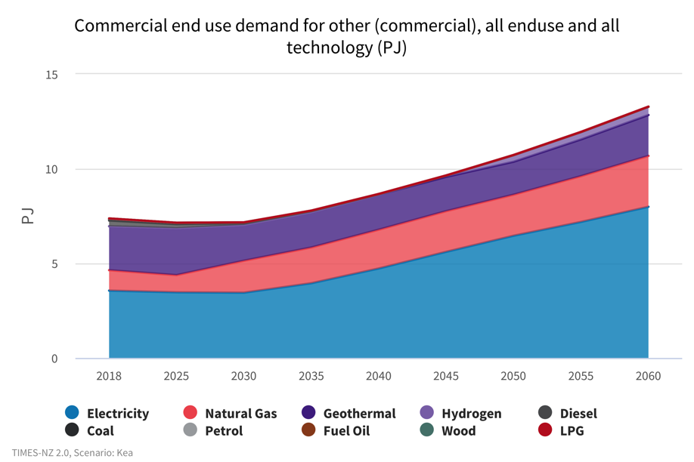
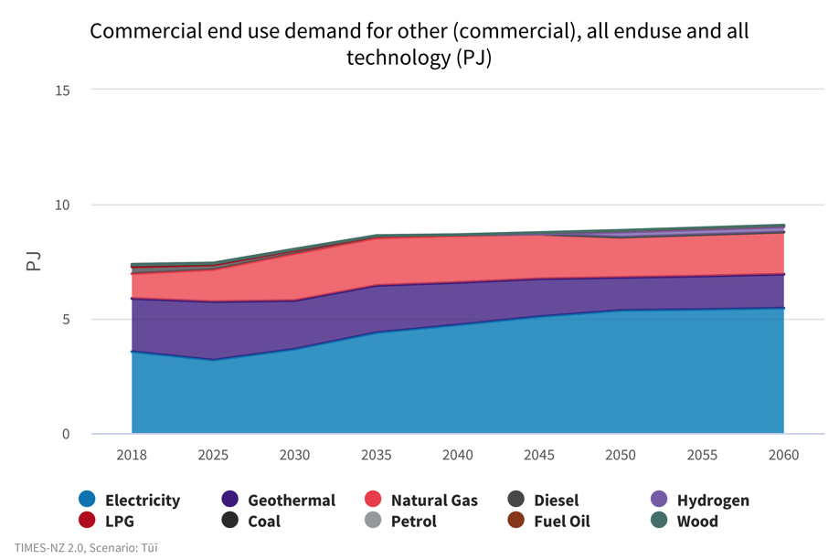
Commercial
What will end-use demand look like?
Kea
Tūī
Notes:
Commercial - What will end-use demand look like?
In Kea, demand increases significantly from 2030 onwards, from 7 PJ to 14 PJ. Most of this demand increase is met by electricity, however natural gas and LPG also increase to meet this. This differs from Tūī where demand levels off at 9 PJ by 2035. This is due to Kea having significant GDP growth in the second half of the scenario, most of which comes from the commercial sector.
Direct use geothermal plays a significant role in this sector, however the geothermal output decreases from 2018 to 2050 in both scenarios, partly due to rising carbon prices affecting the residual GHG emissions from geothermal.
Gas use rises in end uses. There are economic alternatives to gas available for the model, however, in the model it was cheaper to retain some gas in commercial rather than building more generation.

Slide 8
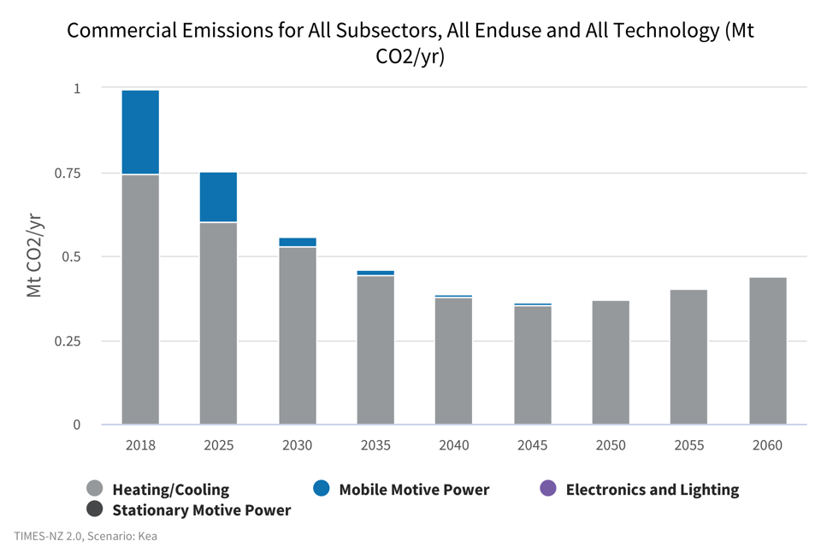
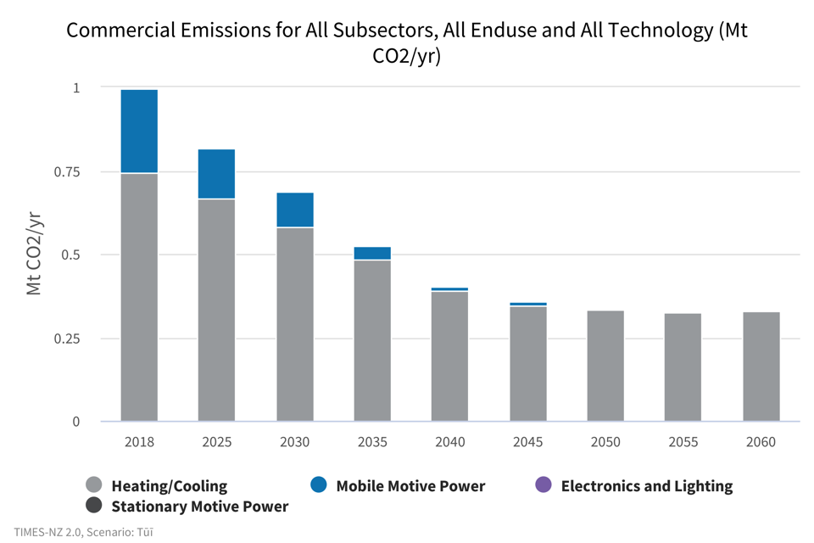
Commercial
Where might we see emissions decrease?
Kea
Tūī
Notes:
Commercial – Where might we see emissions decrease?
In the commercial sector, the majority of emissions comes from mobile power and heating/cooling.
In both scenarios, emissions fall significantly through to 2050, from 1.0 Mt CO2-e in 2018 to 0.37 Mt CO2-e in Kea and 0.33 Mt CO2-e in Tūī.
In Tūī, emissions level off beyond 2050, whereas in Kea they begin to increase again as demand for heating/cooling rises. In Kea, the economy has shifted away from an agricultural, goods-based economy and to a high value products and services economy. This has resulted in increasing energy demand in the commercial sector compared to Tūī which has an economy that continues to rely on agriculture and industrial production.
Mobile motive power emissions decrease quickly in Kea, from 0.25 Mt CO2-e to 0.02 Mt CO2-e by 2030 and zero by 2050. Tūī has a slower decrease in emissions to 0.1 Mt CO2-e and zero in 2050. In both scenarios there is a transition to zero emissions vehicles.

Slide 9
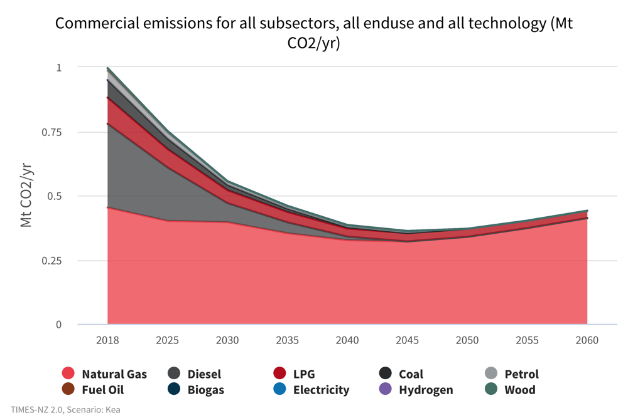
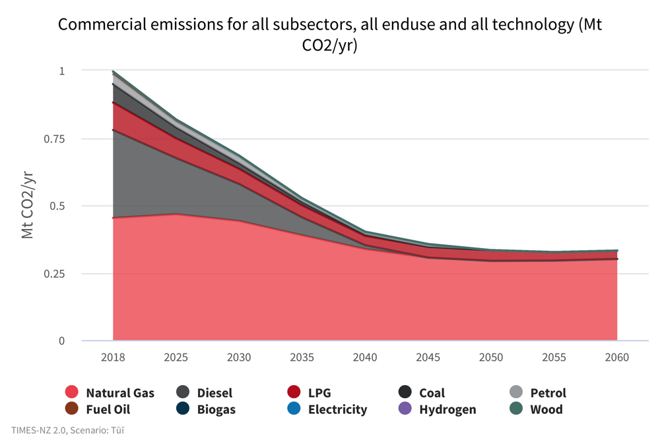
Commercial
What could the emissions footprint in the commercial sector look like?
Kea
Tūī
Notes:
Commercial - What could the emissions footprint in the commercial sector look like?
Overall emissions in the commercial sector decrease rapidly in both scenarios from a peak of 1 Mt CO2-e in 2018 to less than 0.5 Mt CO2-e by 2050.
This is primarily driven by reduction in diesel, petrol, LPG and coal consumption as mobility vehicles electrify and coal heating systems are phased out. In Kea, we see a faster decline in emissions which reach their lowest by 2040 of 0.36 Mt CO2-e before beginning to trend upwards.
In Kea, natural gas use initially decreases slightly from 0.45Mt CO2 to 0.39 Mt CO2-e by 2030 and 0.33 Mt CO2-e by 2050 but begins trending upwards again as demand increases.
This contrasts to Tūī, which sees emissions continue to stay around 0.45 Mt CO2-e through to 2030 before more rapidly decreasing to 0.29 Mt CO2-e by 2050 and levelling off. This is due to rising demand in the later time-steps for Kea, particularly for end-uses without a modelled effective low emissions alterantive.

Slide 10
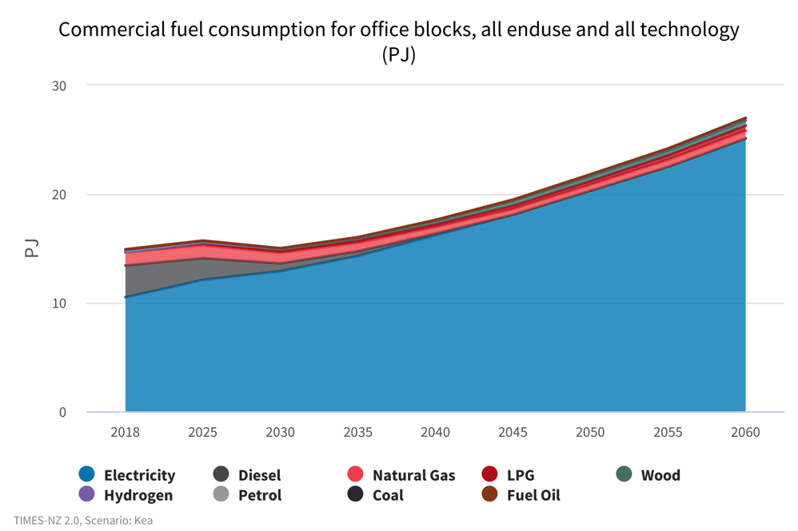
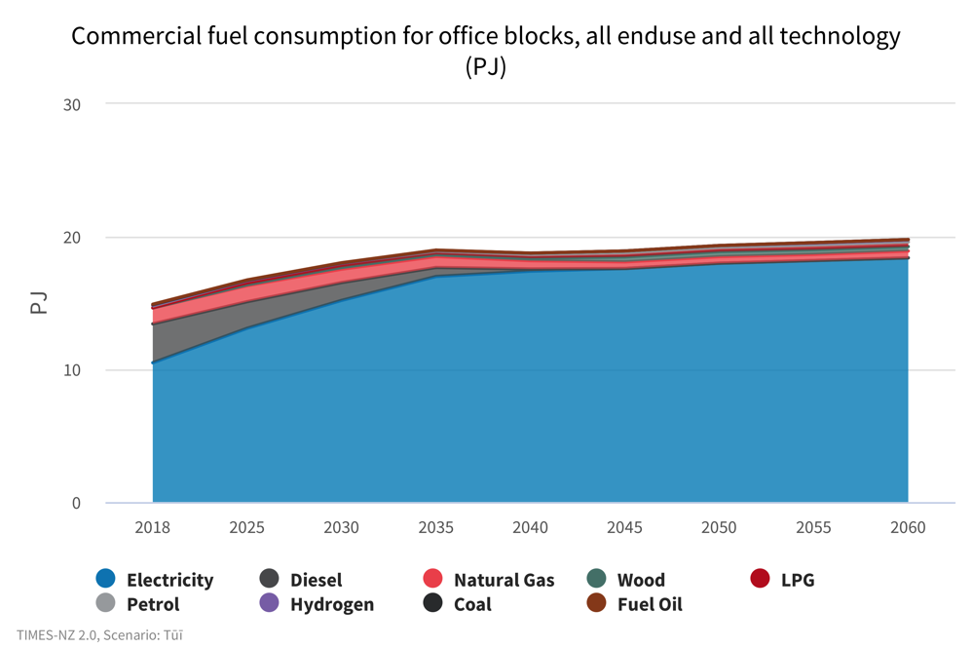
Commercial
How might we manage increasing demand?
Kea
Tūī
Notes:
Commercial - How might we manage increasing demand?
The majority of fuel consumption in office blocks for both scenarios already comes from electricity. A significant proportion of fuel consumption is from diesel for transport, but this reduces to zero by 2030 in Kea and 2040 in Tūī. This is driven by increasing carbon prices and lowering costs of electric vehicles making them more attractive options for transport.
Increasing demand is met by electricity, rather than fossil fuels. Some fossil fuels however, (LPG and natural gas), remain in the system in both scenarios for water heating.

Slide 11
This project has been brought to you by
Find out more at
www.times.bec.org.nz

