Slide 1
New Zealand Energy Scenarios

Slide 2
TIMES-NZ Scenarios
Introduction

Slide 3
How do you tell the story of the future?
What if most Kiwis chose to see climate change as the most important problem to solve?
What would happen if they invested now in new technologies and led the world in decarbonising the economy?
How would New Zealand’s energy sector evolve?
What are the choices and trade-offs?

Slide 4
TIMES-NZ Scenarios
Kea and Tūī

Slide 5
Kea (cohesive) Kea represents a scenario where climate change is prioritised as the most pressing issue and New Zealand deliberately pursues cohesive ways to achieve a low-emissions economy
Tūī (individualistic) Tūī represents a scenario where climate change is an important issue to be addressed as one of many priorities, with most decisions being left up to individuals and market mechanisms

Slide 6
TIMES-NZ Scenarios
5 Key Insights

Slide 7
#1 Energy emissions decline strongly in both scenarios
Energy Emissions
28 MtCO₂-e
10 MtCO₂-e
6.5 MtCO₂-e
2018
2050
Kea
Tūī
Notes:
Both scenarios show strong reductions in energy emissions. Tūī shows a decline to 10 Mt CO2-e/year in 2050 while Kea is even lower at 6.5 Mt CO2-e/year. Moreover, Kea’s more rapid emissions decrease means that the model output indicates cumulative emissions through to 2050 are nearly 25% lower in Kea than under Tui.

Slide 8
#2 Road transport becomes almost fossil-fuel free
Road Transport Fuel Consumption
213 PJ
Fossil fuels
66 PJ
59 PJ
Electricity
28 PJ
3 PJ
2018
2050
Kea
Tūī
Notes:
Electric vehicles are strongly featured in the light vehicle fleet. Both scenarios see a transition of the light vehicle fleet from being almost completely fossil-fuelled to being almost completely electric, Kea by 2050 and Tūī by 2055.

Slide 9
#3 Energy efficiency plays a key role in decarbonisation
Road Transport Energy Use per Distance
4.4 PJ/Billion VKT
1.2 PJ/Billion VKT
1.0 PJ/Billion VKT
2018
2050
Kea
Tūī
Notes:
More efficient technologies increase energy efficiency and decrease energy consumption. For example, road transport energy-use per distance travelled reduces by nearly 80% as a result of EV adoption because EVs are much more efficient than the fossil-fuelled ICE technologies they replace.

Slide 10
#4 Electricity demand roughly doubles in both scenarios
Electricity Consumption
279 PJ
252 PJ
144 PJ
2018
2050
Kea
Tūī
Notes:
Electrification across all sectors results in electricity demand roughly doubling in both scenarios, from 144 PJ in 2018 to between 250-280 PJ in 2050. Under both scenarios, this increased demand is met by very large increases in wind generation accompanied by large increases to solar (primarily grid-scale) in later years by the model.

Slide 11
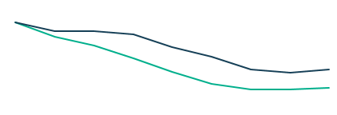
#5 Demand for fossil fuels decreases in both scenarios
All Fossil Fuel Consumption
491 PJ
274 PJ
181 PJ
2018
2050
Kea
Tūī
Notes:
Both scenarios indicate that between now and 2050, energy demand met by fossil fuels goes from 70% to 33% under Kea and 41% under Tūī. In some sectors, particularly road transport, food processing, and residential and commercial, fossil-fuel demand falls to a small fraction of current levels. Most remaining demand is in hard-to-abate sectors.

Slide 12
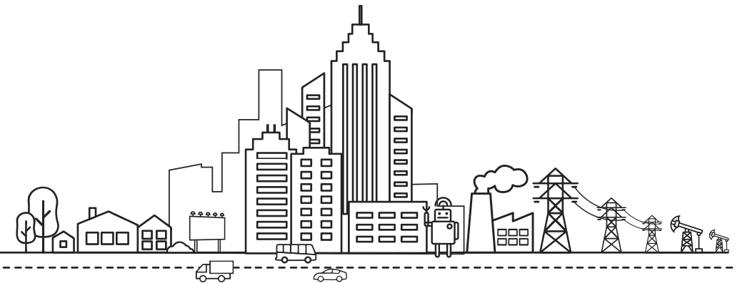
TIMES-NZ Scenarios
All Sectors

Slide 13
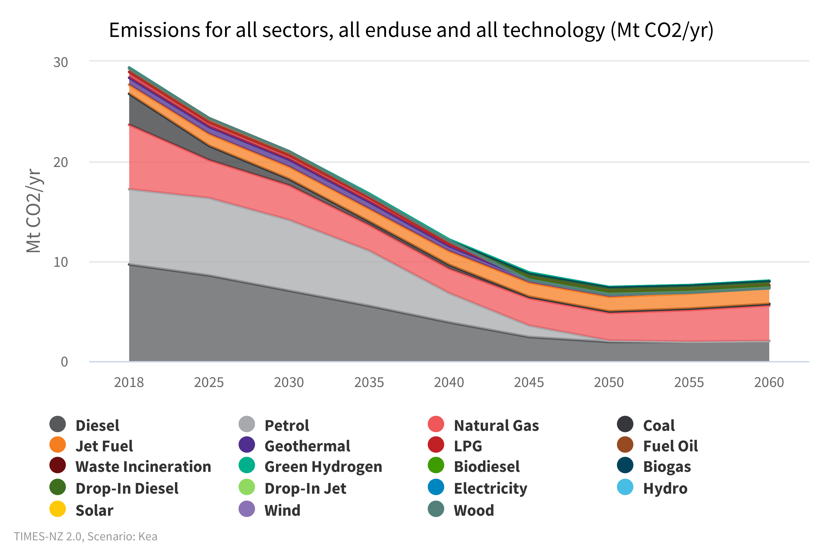
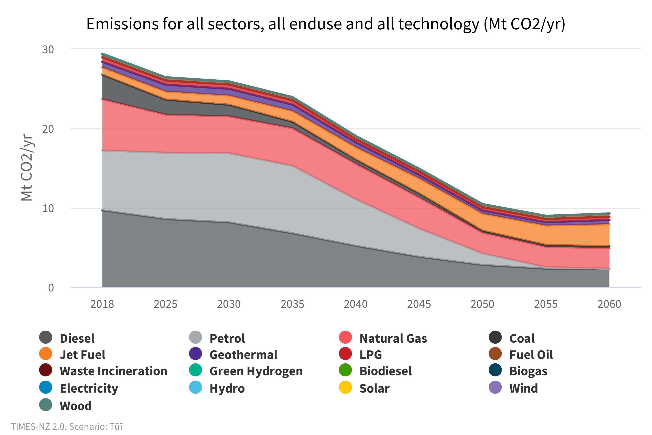
All Sectors What might our energy sector carbon emission footprint look like?
Kea
Tūī
Notes:
All Sectors - What might our energy sector carbon emission footprint look like?
Both scenarios show strong reductions in energy emissions. Tūī shows a decline to 10 Mt CO2-e/year in 2050 while Kea is even lower at 6.5 Mt CO2-e/year in 2050. Moreover, Kea’s more rapid emissions decrease means that the model output indicates cumulative emissions through to 2050 are nearly 25% lower in Kea than under Tūī.
The most striking difference between Kea and Tūī in this regard is the presence of drop-in diesel and jet fuel, which is lacking in Tūī. This, coupled with a general decrease in domestic air travel, has the effect of significantly reducing the total and percentage amount of jet fuel emissions in Kea compared with Tūī.
Kea largely eliminates petrol as a source of emissions between 2050 and 2055, with Tūī seeing the same between 2055 and 2060. This is due to electrification of the vehicle fleet. Note that diesel remains as a significant contributor under both scenarios, in large part due to an inadequate transition to electrification or hydrogen for heavy machinery.

Slide 14
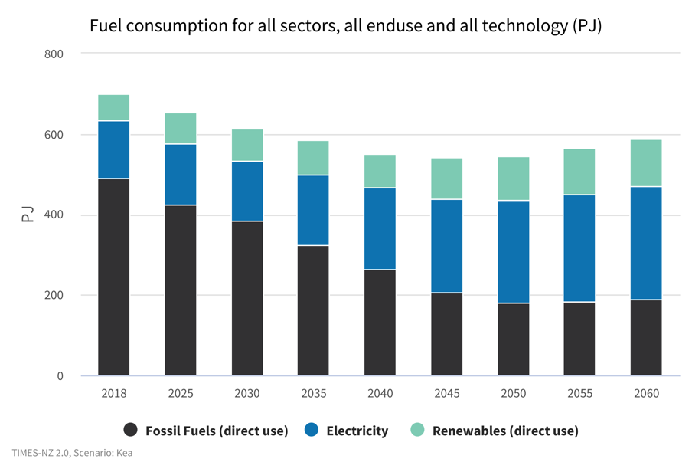
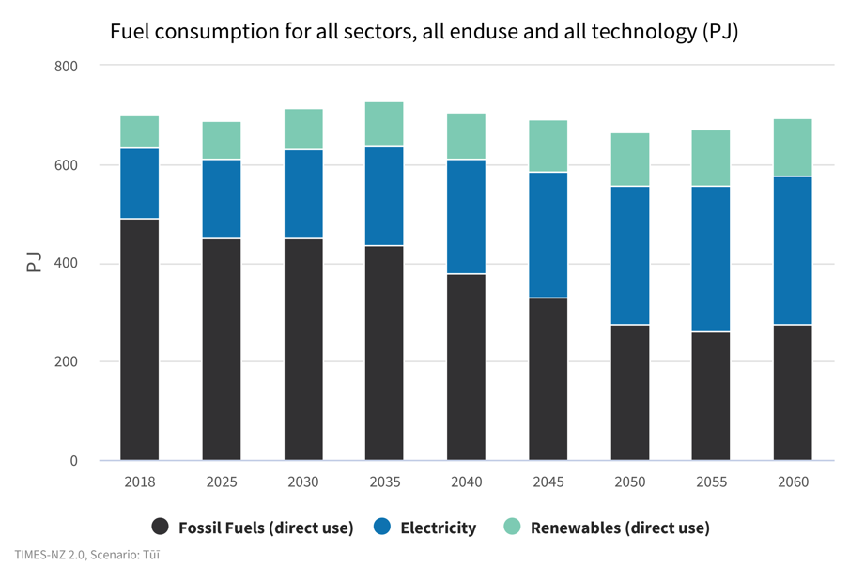
All Sectors What and how much energy might we consume?
Kea
Tūī
Notes:
All sectors - What and how much energy might we consume?
Kea and Tūī both show a gradual increase in electrification, with a corresponding drop in direct fossil fuel consumption. Transport is the most prominent driver here, with air travel and heavy vehicles/machinery accounting for a significant portion of the remaining reliance on fossil fuels.
Direct use of renewables plays a similar, although slightly more prominent role in Kea.
Overall consumption declines steadily in Kea until 2050, when electrification sees an increase of a level that has the effect of increasing overall consumption. This is the driver of increases seen at both 2055 and 2060.
Much the same can be seen in Tūī, except with a higher base level as a result of a more prominent reliance on direct use of fossil fuels. A lack of technological development is in large part responsible for this.
Fossil fuel consumption sits at 181PJ in 2050 under Kea (33%), and 274PJ (41%) under Tūī.

Slide 15
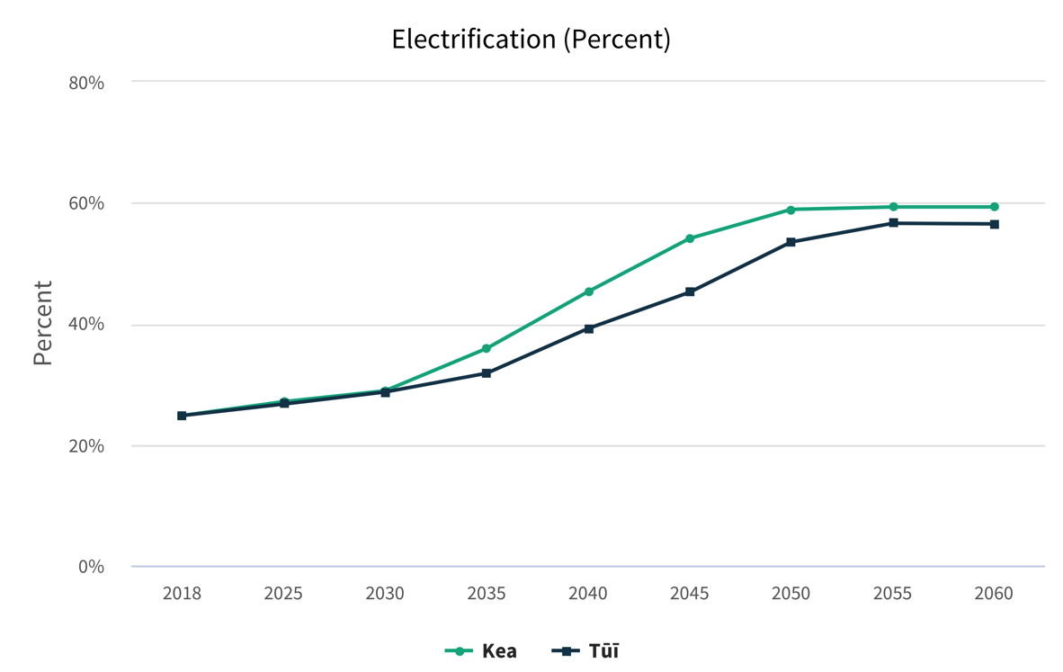
All Sectors To what extent might we be able to electrify our economy?
Notes:
All Sectors - To what extent might we be able to electrify our economy?
Both scenarios reach peak electrification – of around 60% – between 2050 and 2055, although Kea goes further and faster.
A driver for the faster-moving Kea is the faster electrification of New Zealand’s vehicle fleet.

Slide 16
TIMES-NZ Scenarios
Electricity

Slide 17
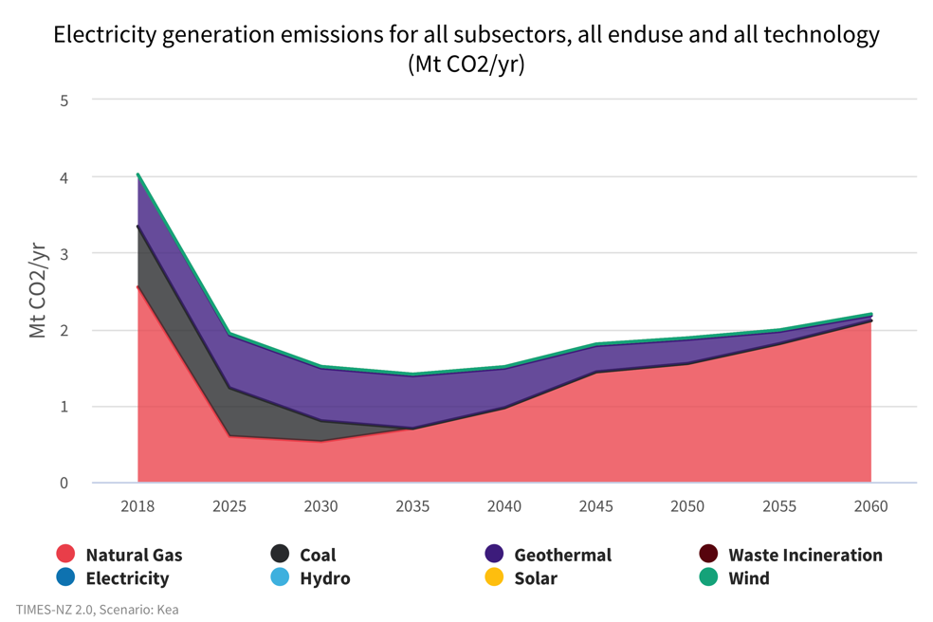
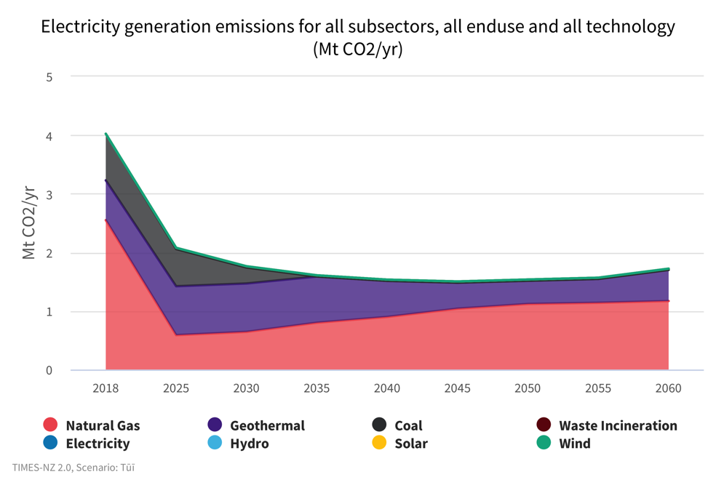
Electricity
What might our carbon emission footprint look like?
Kea
Tūī
Notes:
Electricity – What might our carbon emission footprint look like?
In both scenarios, electricity emissions halve by 2030. Emissions from coal are removed by 2035 in both scenarios due to increasing carbon prices (Huntly is assumed to retire, but no new coal generation is built by the model due to costs and carbon prices), while emissions from gas initially decrease then begin to increase from 2035 onwards as gas continues to play a firming role.
In Kea, a growing proportion of emissions come from natural gas with 1.5 Mt CO2-e by 2050, as opposed to 1.1 Mt CO2-e in Tūī in 2050.
Geothermal, on the other hand, remains a greater contributor to emissions in Tūī, with the fuel source accounting for a quarter of total electricity sector emissions 26% in 2050 as opposed to 17% in Kea.
After an initial fall in Kea, from 4 Mt CO2-e to 1.4 Mt CO2-e in 2035, emissions increase rising to1.8 Mt CO2-e by 2050. This is due to increasing gas consumption for winter peaking.
Interestingly, emissions are held slightly lower for longer in Tūī, with an initial decrease to 1.6 Mt CO2-e in 2035 then remaining fairly steady below 1.6 Mt CO2-e until 2060. Higher levels of solar generation, and an ongoing contribution from geothermal, plus an expansion of hydro generation reduces our reliance on natural gas slightly.

Slide 18
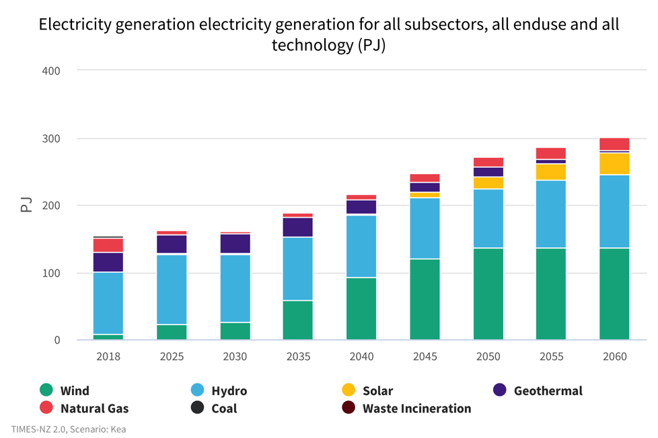
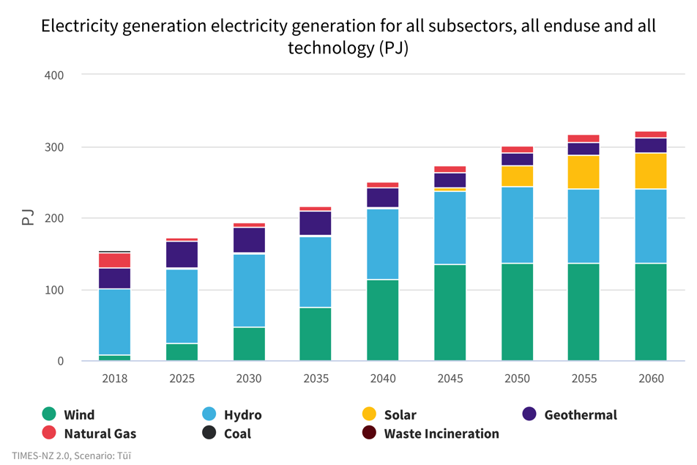
Electricity
What might electricity generation look like?
Kea
Tūī
Notes:
Electricity – What might electricity generation look like?
Electricity generation increases significantly as demand from the industrial, commercial and residential sectors grow. Electrification across all sectors results in electricity demand roughly doubling in both scenarios, from 144 PJ in 2018 to around 270 PJ.
Under both scenarios, this increased demand is met by very large increases in wind generation accompanied by large increases to solar (primarily grid-scale) in later years by the model.
Under both scenarios, winter gas peaking is retained, and there is a gradual decline in geothermal generation. Under Tūī, hydro generation expands where possible, reducing dependence on gas peakers.
Natural gas continues to play a role, while coal reduces in the next 15 years and geothermal decreases from 2035 onwards.
Electricity supplies up to 59% in Kea and 54% in Tui of all energy demand by 2050.

Slide 19
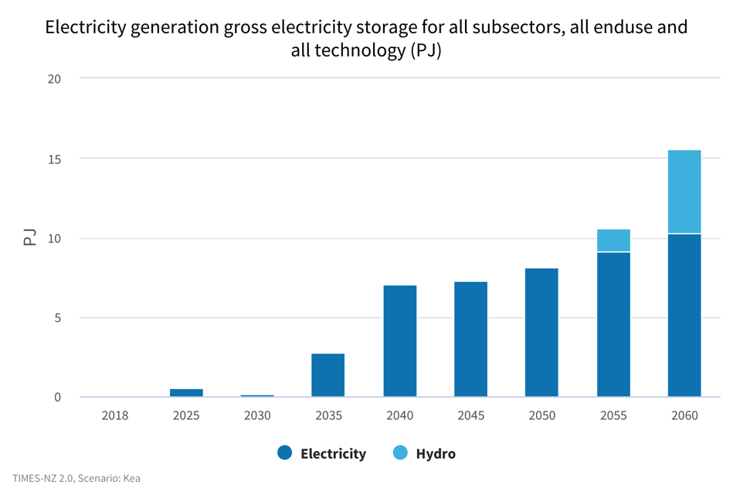
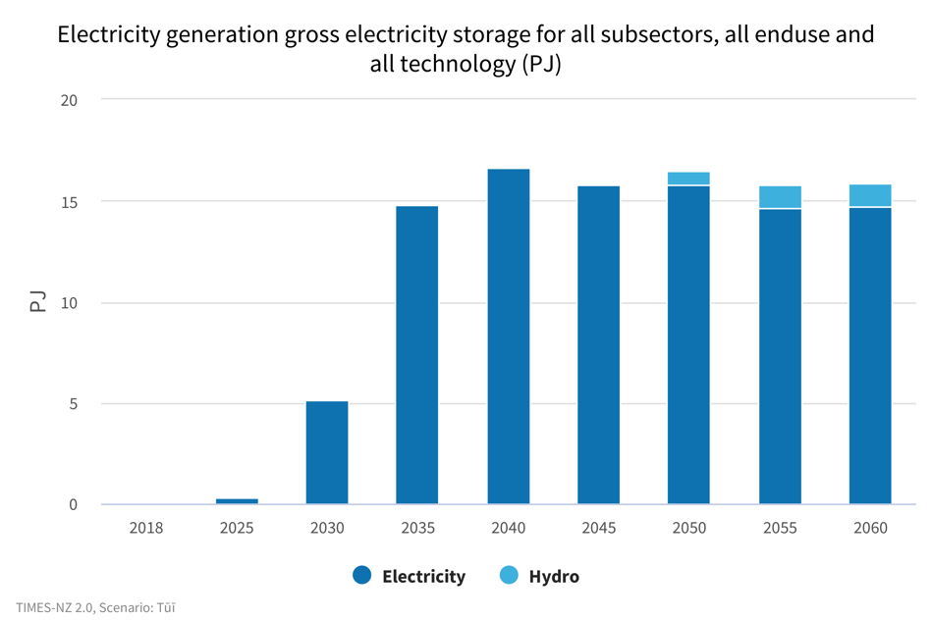
Electricity
How much electricity storage might be used in an average year?
Kea
Tūī
Notes:
Electricity – How much electricity storage might be used in an average year?
With increasing renewable generation more electricity storage is seen as economic by the model. This is primarily provided as electrical storage batteries with 9 PJ by 2050 in Kea and 15 PJ in Tūī.
Both scenarios use electricity storage to meet demand peaks, particularly from lithium-ion batteries.
Both scenarios make limited use of large-scale pumped hydro from 2050 onwards, while Tūī makes greater use of battery storage.
The model does not specifically model dry years, so the storage requirement findings represent average hydro years only.

Slide 20
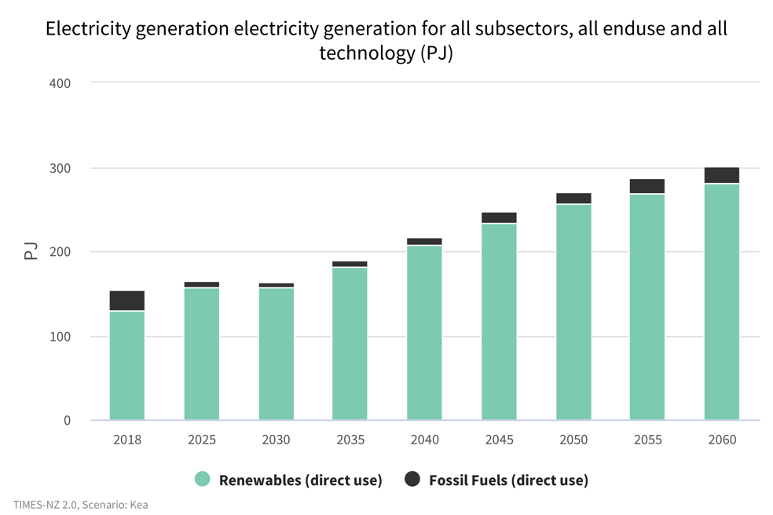
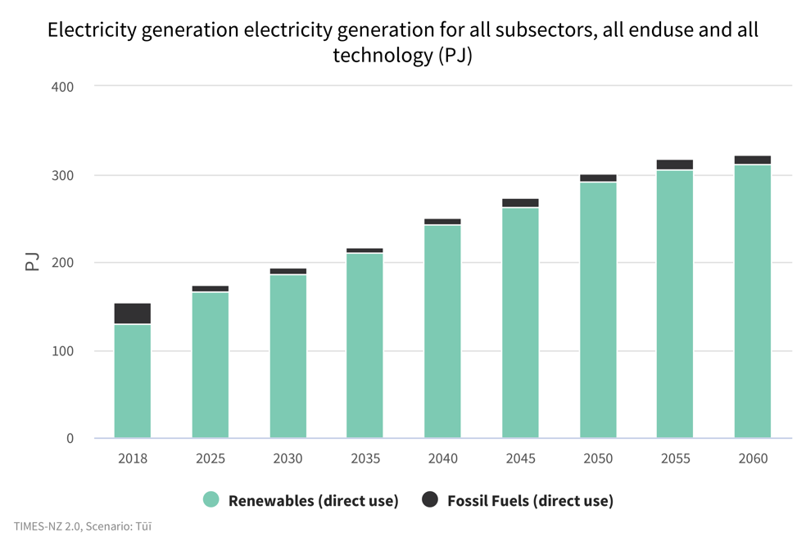
Electricity
Does the model show us reaching 100% renewable electricity?
Kea
Tūī
Notes:
Electricity – Does the model show us reaching 100% renewable electricity?
Both scenarios converge on a very high renewable electricity percentage of around 95% from 2030 onwards.
Tūī includes higher levels of geothermal and solar generation and battery storage.
In contrast, in Kea the higher carbon price drives out geothermal generation earlier. Natural gas provides firming to meet winter energy and capacity margins throughout the modelled period.
Both scenarios continue to use natural gas as a flexible fuel for meeting electricity daily and seasonal peak demands. TIMES-NZ results give an indicative picture of the electricity system, further exploration of more extreme scenarios requires the use of additional modelling tools.

Slide 21
TIMES-NZ Scenarios
Transport

Slide 22
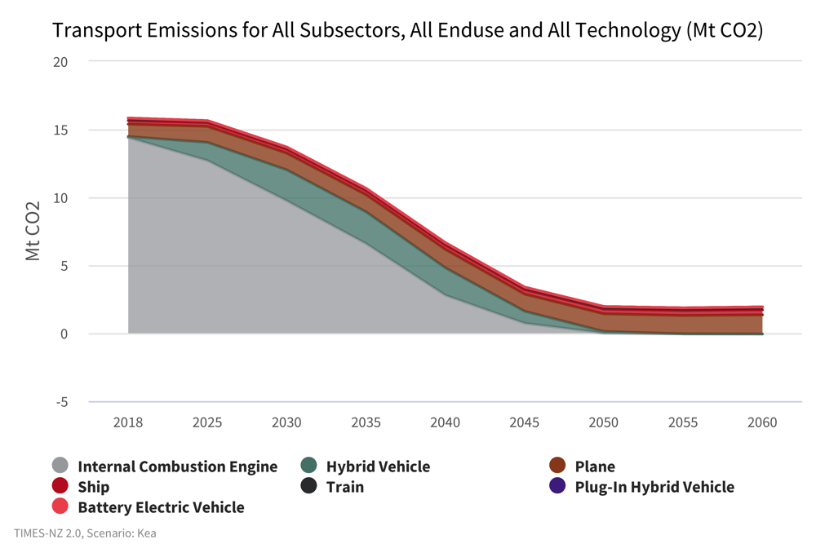
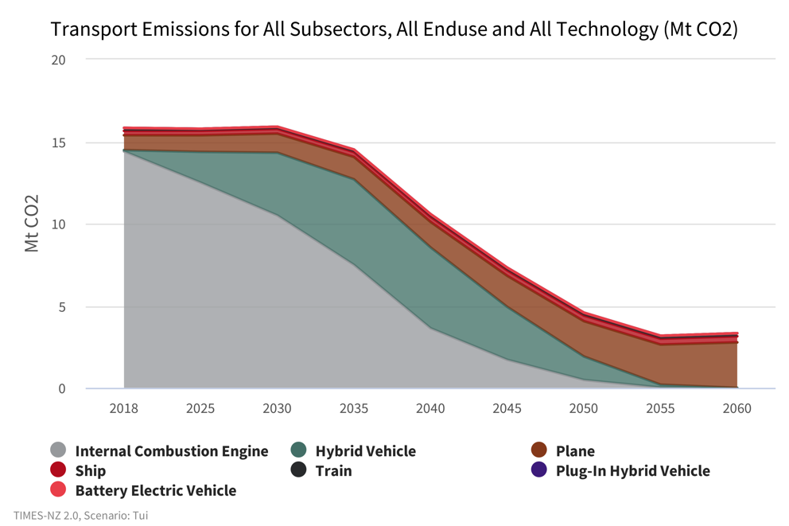
Transport
What technology might help us to lower our carbon footprint?
Kea
Tūī
Notes:
Transport - What technology might help us to lower our carbon footprint?
Transport contributes roughly 20% of New Zealand’s gross emissions, about the same as energy use. The vast bulk of that comes from road transport.
Transport emissions have increased more than any other emissions source, rising 90% between 1990 and 2018 compared with 24% for gross emissions across the whole economy.
In Tūī, emissions plateau before slowly declining closer to 2030. In Kea, we see emission reductions happening after 2025.
In Kea, emissions begin to fall immediately as the emissions from internal combustion engines fall, as electric and hybrid vehicle uptake accelerates, and modeshift slowly rises in the overall vehicle-kilometres travelled. Hybrid vehicles act as a transition technology, peaking in 2030 before reducing to zero by 2050. Both internal combustion and hybrid vehicle emissions drop to zero by 2050.
In Tūī, overall emissions remain steady to 2030. This plateau in Tūī is attributed to reductions in emissions from electric and hybrid vehicles being offset by the increasing vehicle fleet. There are more than double the emissions from hybrid vehicles in Tūī compared to Kea as they are more widely adopted in Tūī due to carbon price and technology cost and perfroamnce assumption differences between the two scenarios.

Slide 23
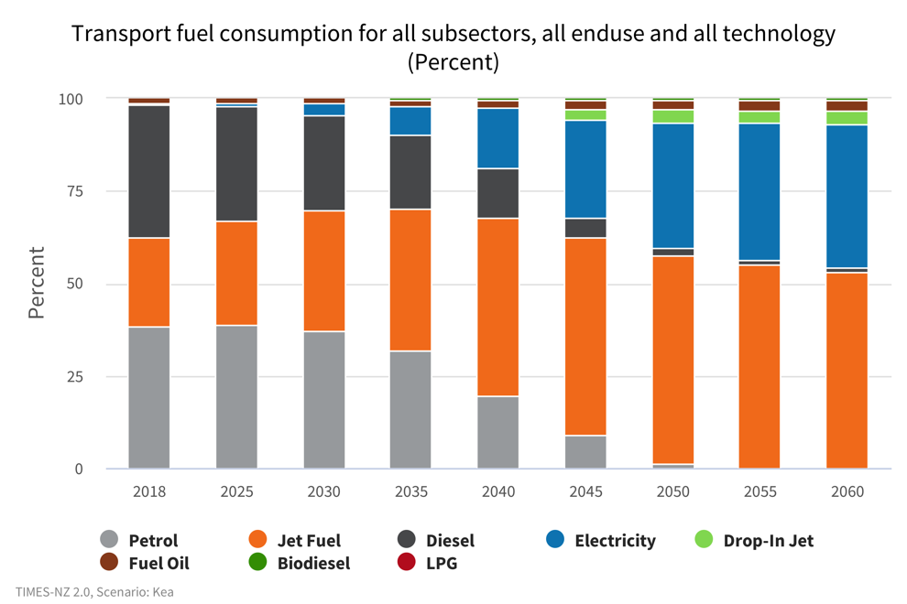
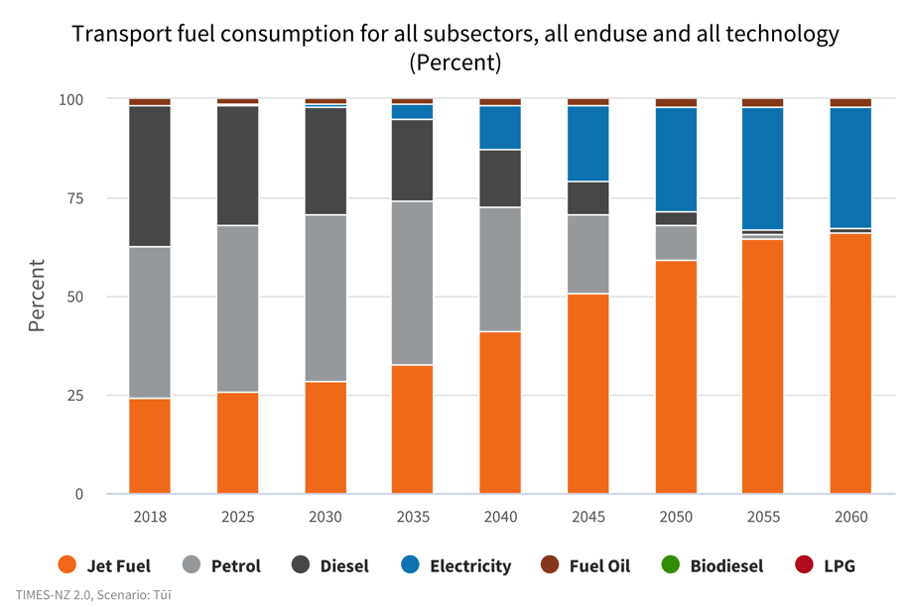
Transport
How might fuel consumption impact our emission footprint?
Kea
Tūī
Notes:
Transport - How might fuel consumption impact our emission footprint?
In Kea, emissions begin to fall immediately, from 15.8 Mt CO2-e in 2018 to 13.69 Mt CO2-e in 2030, then to 3.6MtCO2-e by 2050. This is driven by reduction in petrol and diesel consumption as more vehicles transition to electric faster.
This is in contrast with Tūī where emissions remain steady to 2030 before falling to 4.57 Mt CO2-e by 2050.
In Kea emissions level off by 2050 at around 2.18 Mt CO2-e, suggesting that the minimum level of carbon emissions has been reached with current technology. This is because technologies for decarbonising the airline industry are still under development which by 2050 makes up for more than 50% of fuel consumption.
Diesel emissions decrease steadily in both scenarios from 7.28 Mt CO2-e to 0.25 Mt CO2-e in Kea and 0.65 Mt CO2-e in Tūī. This decrease in diesel emissions is offset in Tūī, however, by rising petrol emissions through to 2030.
In Tūī, emissions from petrol increase from 7.43 Mt CO2-e to 8.67 Mt CO2-e in 2030 before falling.
Jet fuel emissions increase more in Tūī by 2050 from 0.907 Mt CO2-e to 2.15 Mt CO2-e as the demand for air travel increases. This contrasts with Kea where jet fuel emissions increase more modestly to 1.46 Mt CO2-e.

Slide 24
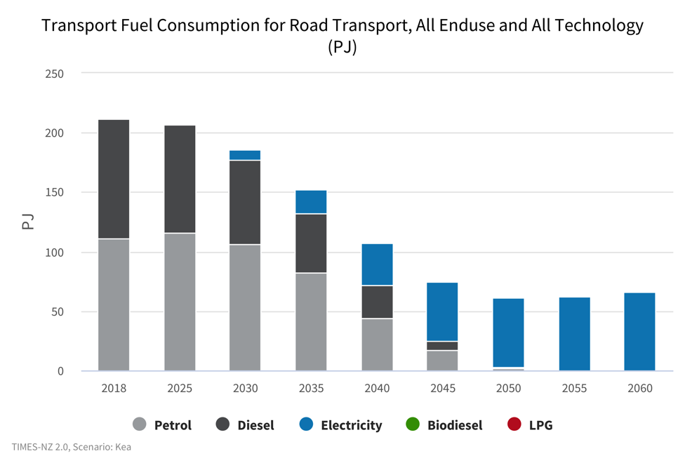
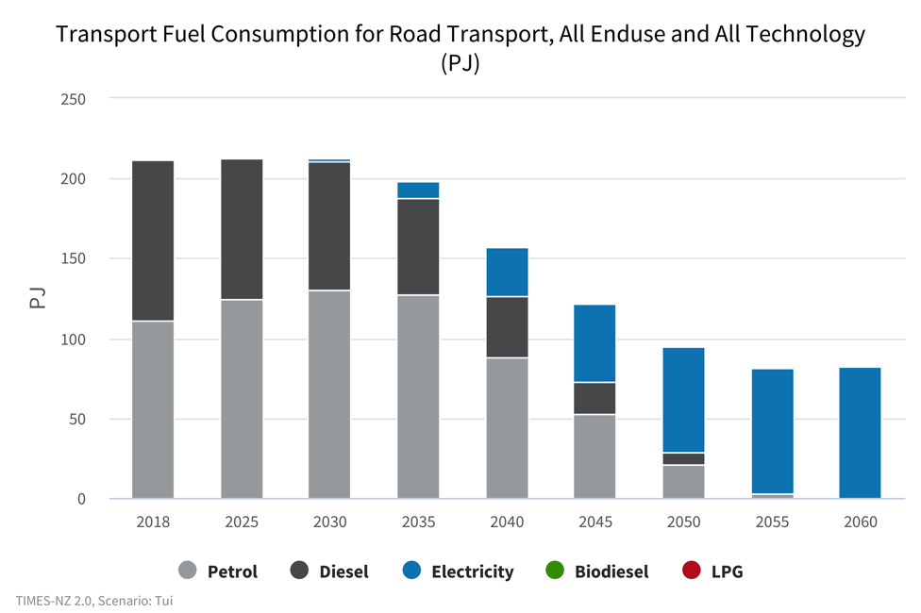
Transport
How might road transport look?
Kea
Tūī
Notes:
Transport- How might road transport look?
The road transport system shows a major shift in energy from the current 100% fossil fuel to almost entirely electric by 2050 (Kea) and 2055 (Tūī).
In Kea, by 2050 fuel consumption is 95% electric while in Tūī, 60% of energy consumption will be electric. Note that fuel consumption shares do not reflect travel as electric vehicles are much more energy efficient.
In Tūī, petrol consumption increases to 2030 as the number of overall vehicles increases, with reductions in energy consumption from diesel being offset by increased consumption of petrol. The phasing out of fossil fuels is slower than in Kea, with petrol remaining a larger share of energy consumption for longer before being more slowly replaced by electricity.
Diesel takes longer to be phased out in Tūī, with 7 PJ of diesel still being consumed by 2050 compared to no diesel by 2050 in Kea. This is due to the higher cost of battery electric vehicles for longer, and larger fleet in Tūī which results in a slower phaseout.
Overall energy consumption for road transport drops from 212 PJ to 61 PJ by 2050 in Kea and 94.5 PJ in Tūī. This is due to the more efficient nature of electric vehicles compared to internal combustion engines and so less energy is required to complete transport tasks.

Slide 25
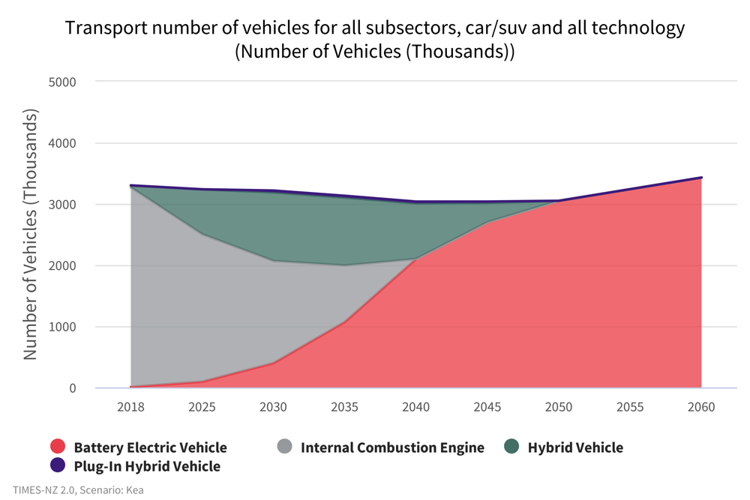
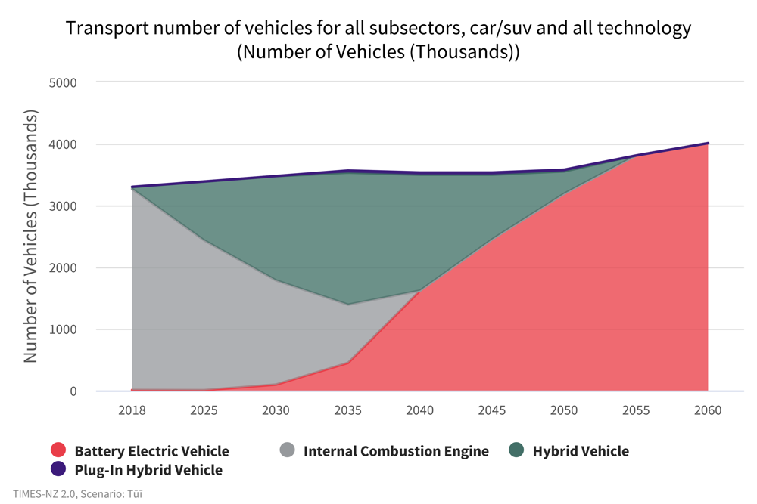
Transport
What cars might we drive?
Kea
Tūī
Notes:
Transport - What cars might we drive?
The number of cars and SUVs in Kea decreases slightly through to 2050 from 3.3 million to 3.0 million, compared with Tūī where vehicle numbers increase slightly from 3.3 million to 3.6 million by 2050.
In Tūī, cities continue to grow and sprawl, resulting in greater need for cars and therefore higher overall numbers. In Kea, cities are designed to encourage modeshift to public transport and active transport which results in lower overall demand for vehicles compared to Tūī.
Kea also sees a faster uptake of electric cars as their price falls more quickly, and other technology parameters improve faster, making them a more attractive option to replace internal combustion engine vehicles. By 2050 there are more electric vehicles in Tūī than in Kea. However, there are still more than half a million fossil fuel powered vehicles (albeit more efficient hybrids).
In Tūī, hybrid vehicles are preferred in the short term due to relative costs which result in greater numbers purchased to replace internal combustion engines, and they make up over half of cars by 2035. However, these are quickly replaced by battery electric vehicles from 2040-2050 as BEV price falls and they become cheaper to own than hybrid vehicles.
HEVs are preferred in Tūī as BEV supply is constrained to model lower access to BEVs.

Slide 26
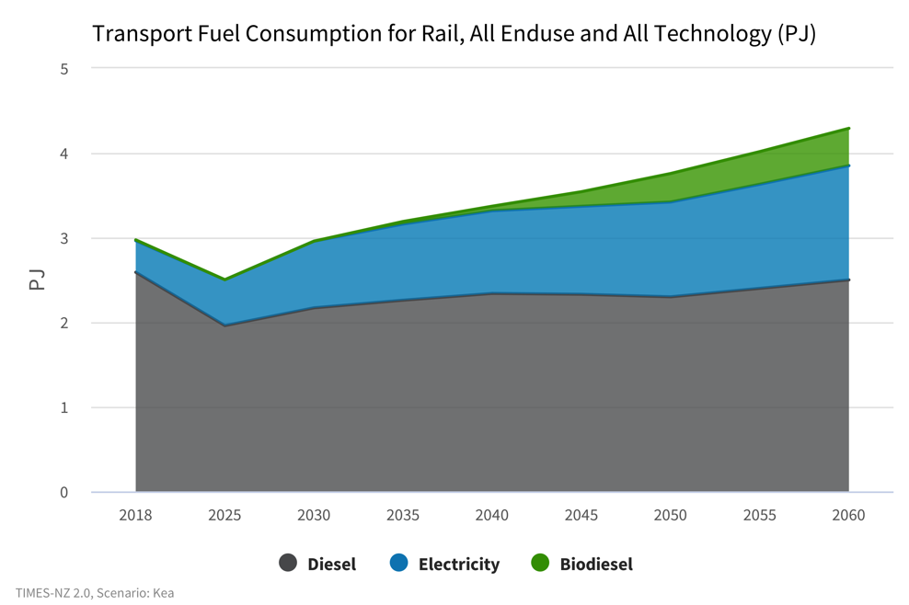
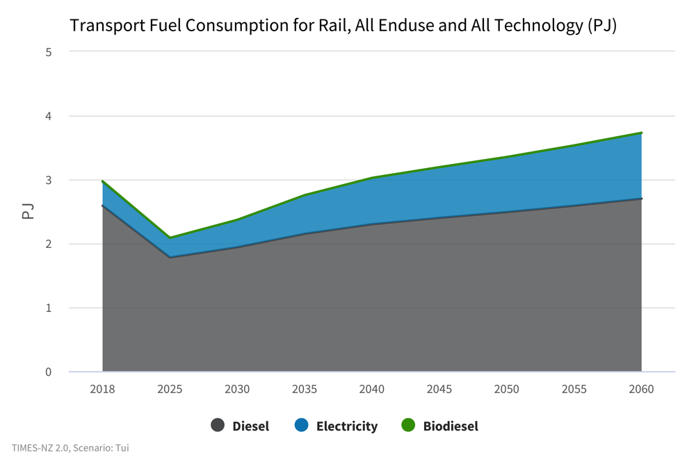
Transport
What might drive our energy consumption in rail?
Kea
Tūī
Notes:
Transport - What might drive our energy consumption in rail?
Fuel consumption decreases in both scenarios through to 2025 before then increasing.
In Kea, demand grows larger than in Tūī due to rail being prioritised as a lower emissions alternative to road transport. In Kea, energy consumption grows to 3.76 PJ in 2050 whereas in Tūī it climbs to 3.35 PJ.
Diesel consumption drops from 2.59 PJ in 2018 to 2.17 PJ in 2030 and only increases slightly to 2.3 PJ by 2050. Most of the increase in energy consumption is met by electricity and biodiesel. Biodiesel plays a small nut growing role in Kea, accounting for 9% of energy consumption by 2050.
Tūī on the other hand does not have biodiesel as a part of the energy mix, relying on diesel and electricity. Diesel consumption is slightly higher in Tūī by 2050 at 2.49 PJ compared to 2.3PJ in Kea, and electricity consumption by 2050 is lower at 0.86 PJ compared to 1.12 PJ in Kea. This means that in 2050, fossil fuels will still make up a much larger percentage of the energy use mix at 74% in Tūī compared to only 61% fossil fuels in Kea.
Overall emissions increase in both Kea and Tūī, as demand and consumption of diesel increases. Emissions decrease from 2018 levels of 0.18 Mt CO2-e to 0.15 Mt CO2-e in Kea and 0.13 Mt CO2-e in Tūī by 2030. By 2050, emissions in Kea grow back to 0.18 Mt CO2-e and Mt CO2-e in Tūī. Higher emissions in Kea are attributed to higher demand for rail travel through mode shift away from road transport.
The rail sector shows opportunities to offset emissions through the introduction of biofuels. This can be seen in Kea where there are significant offsets through the introduction of biofuels which absorb carbon as they are grown. By 2050, biofuels in Kea will offset emissions by 14% and resulting in net emissions in Kea that are lower than Tūī despite higher fuel consumption.

Slide 27
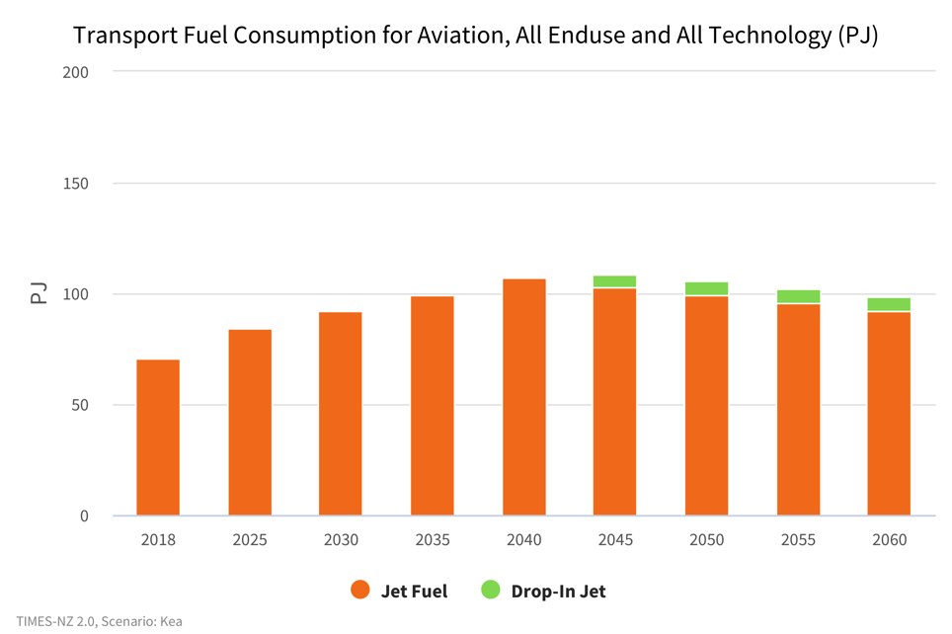
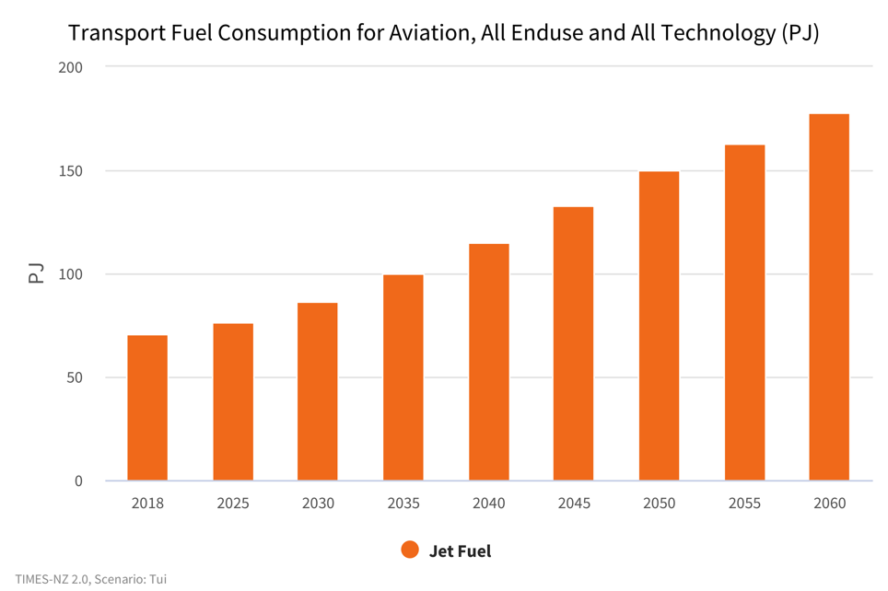
Transport
What is the role of demand reduction for areas that are difficult to decarbonise?
Kea
Tūī
Notes:
Transport- What is the role of demand reduction for areas that are difficult to decarbonise?
The aviation industry is an area where decarbonisation is challanging. There are currently no economically viable alternatives to jet fuel for aviation, with biofuels and forms of hydrogen being currently researched to be introduced.
In Kea and Tūī, demand management results in differences in fuel consumption and therefore emissions. In Kea, consumption continues to grow from 2018 levels to peak in 2040 and fall slightly to 99.2 PJ in 2050. This is caused by reduction in demand for air travel as modeshift to lower emissions travel such as by train for short trips is encouraged. This differs to Tūī where demand for jet travel continues to increase at a steady rate, resulting in 50% more fuel consumption at 150 PJ by 2050.

Slide 28
TIMES-NZ Scenarios
Agriculture

Slide 29
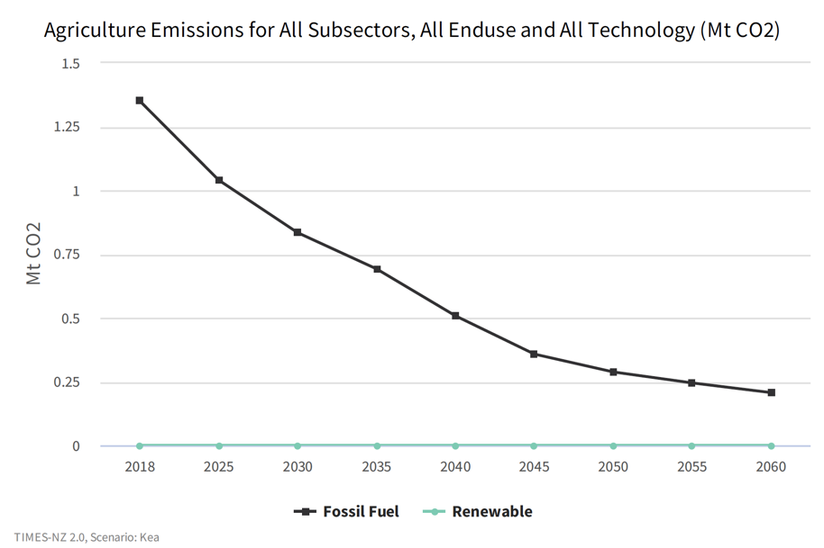
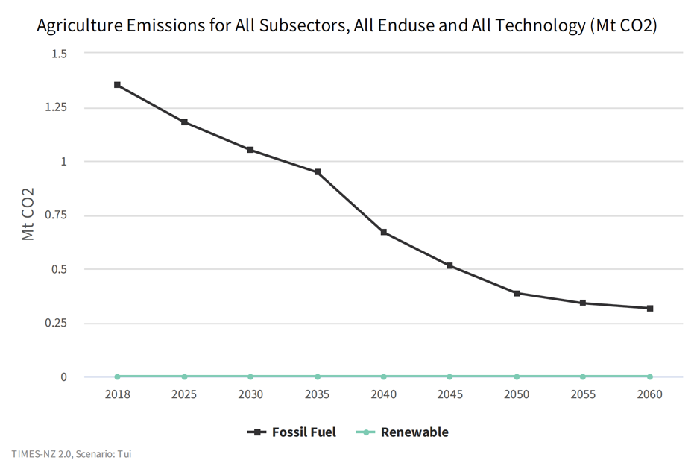
Agriculture
How close to zero emissions does the model get?
Kea
Tūī
Notes:
Agriculture energy emissions - How close to zero emissions does the model get?
Zero energy emissions are not modelled as being reached in this sector by 2050. Both Kea and Tūī have emissions settling around the same mark – Kea at 0.207 and Tūī at 0.316 Mt CO2-e respectively (around 25% or current levels).
Kea shows a sharper drop in emissions.
This sector can be significantly decarbonised. Technological development in heavy equipment and farm vehicles could further assist the sector to full decarbonisation.

Slide 30
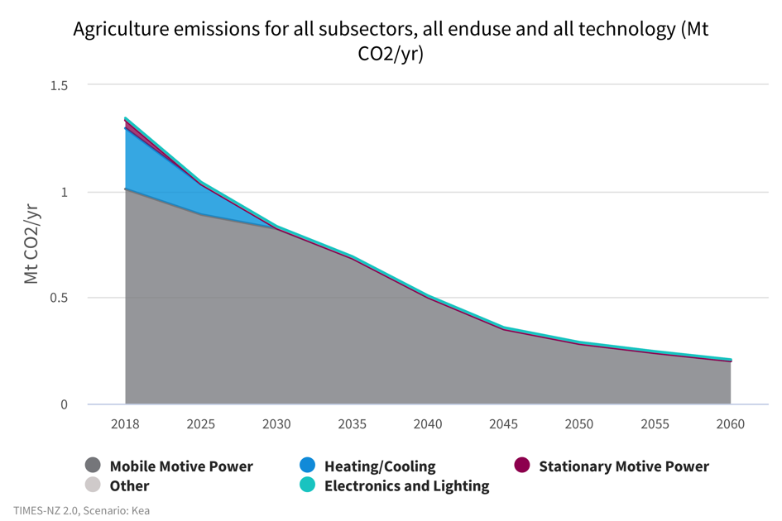
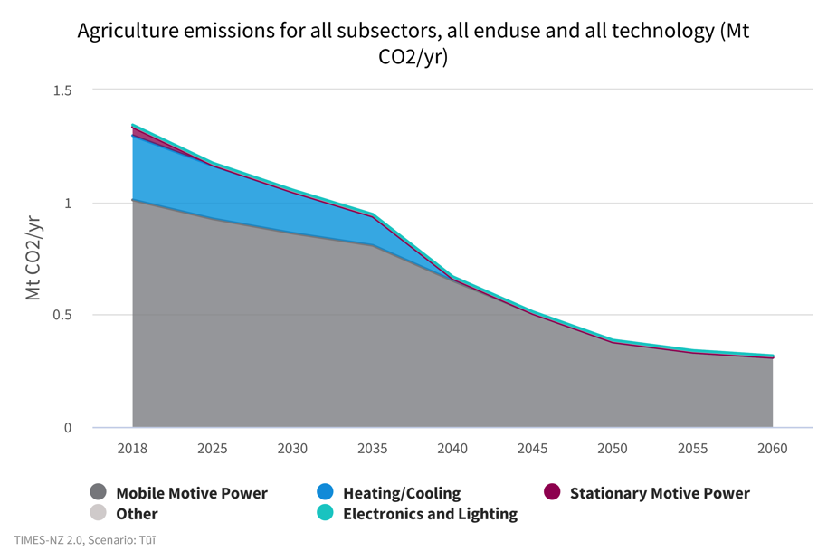
Agriculture
What technologies might contribute to emission reductions?
Kea
Tūī
Notes:
Agriculture - What technologies might contribute to emission reductions?
Faster technological development under Kea is responsible for the quicker elimination of some emissions sources – notably boilers (light blue) and forestry equipment (teal and dark green).
Overall emissions are lower in Kea than Tūī. The difference is .109 Mt CO2-e difference by 2050 – as outlined on the previous slide – roughly a third less. Note that all these numbers are small in the scheme of things.
The theme between Kea and Tūī is that a lack of zero carbon technology for heavy machinery and fishing vessels stands in the way of reaching a zero energy emissions agricultural sector. The faster emissions-reducing tech can be developed, the faster this sector can make a significant contribution. As noted in subsequent slides, hydrogen has the potential to play a useful role here.

Slide 31
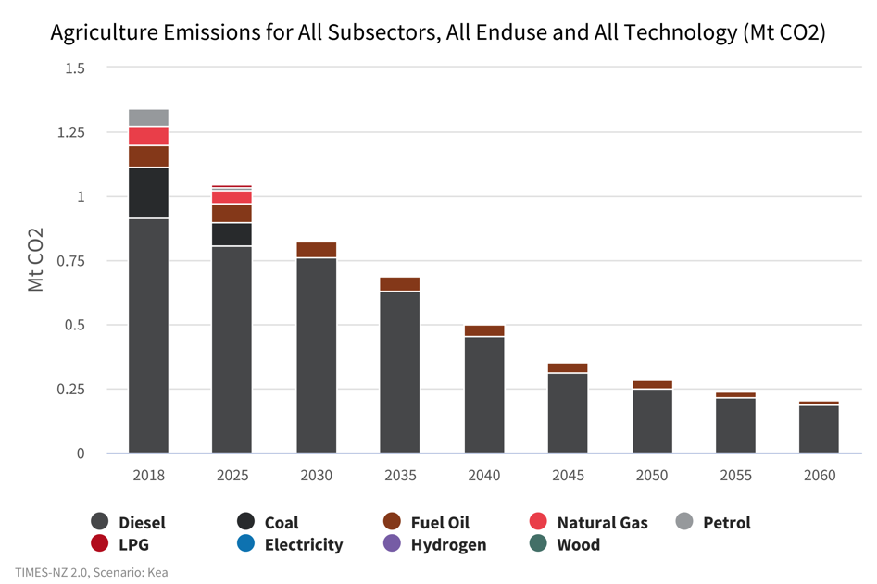
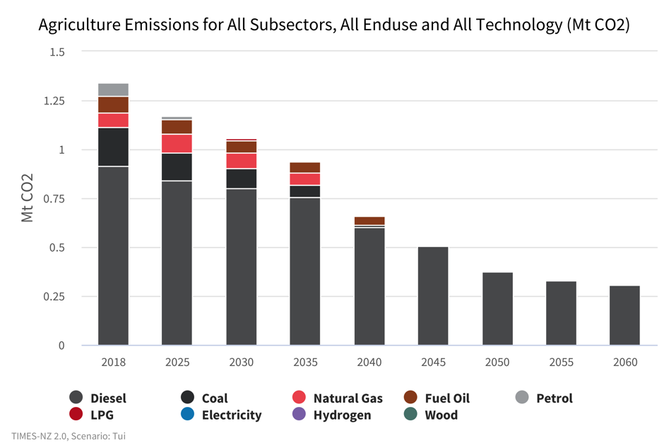
Agriculture
Where might we see emissions sticking around for longer?
Kea
Tūī
Notes:
Agriculture - Where might we see emissions sticking around for longer?
Diesel is the main source of carbon emissions in both Kea and Tūī. This is from a variety of sources, including heavy trucks and farming vehicles (tractors and the like).
Full decarbonisation in this sector will be reliant on technological development in order to give businesses opportunity. This also includes forestry.
It is also worth noting that liquid biofuels in these charts are shown as diesel as they are usually combined with an existing fuel.
Coal is the second most prominent source in the starting point, but is eliminated by 2030 under Kea, and 2040 under Tūī. This is largely as a result of coal boilers being phased out and transitioning to wood as a fuel. Indoor cropping transitioning away from coal/natural gas/diesel to electricity/wood/geothermal also plays a role.

Slide 32
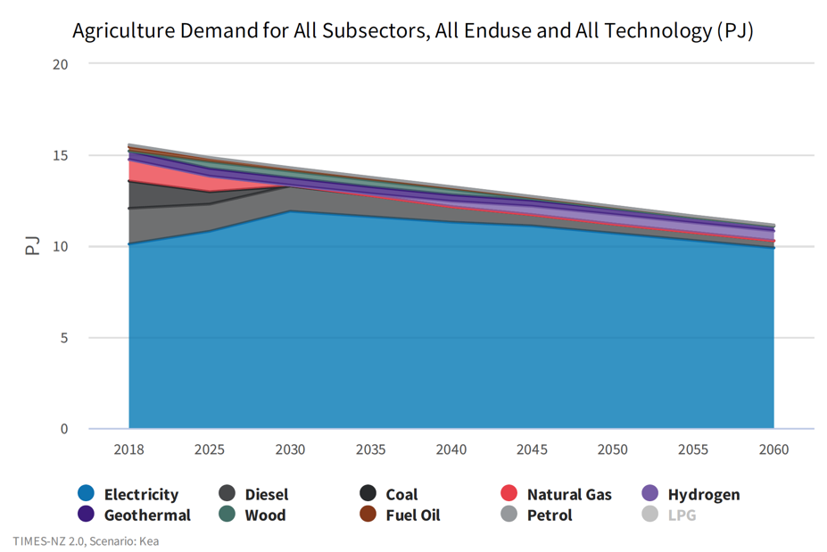
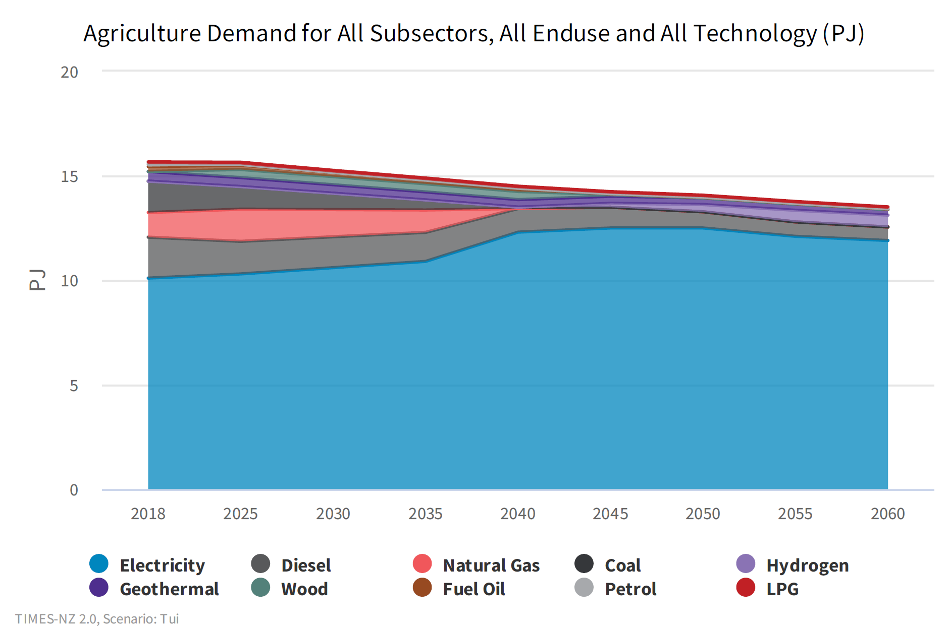
Agriculture
How much energy demand might we see?
Kea
Tūī
Notes:
Agriculture - How much energy demand might we see?
Total demand under Kea in 2050 is around 12 PJ, and 14 PJ under Tūī. Tūī shows little shift in demand over the course of time.
Demand is largely met by increasing electrification. Diesel continues to play a role, albeit a smaller one, with hydrogen having an increasing, although still limited role in both scenarios.
Demand for natural gas and coal extends beyond 2030 in Tūī. This is not the same in Kea, due to faster overall technological development and adoption due to the higher carbon price.
There is a slow decline in overall agricultural activity in the input assumptions.

Slide 33
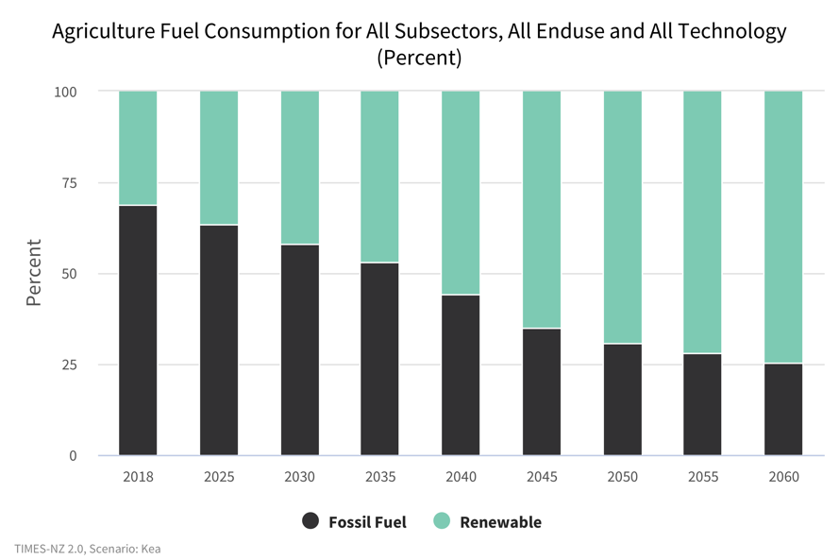
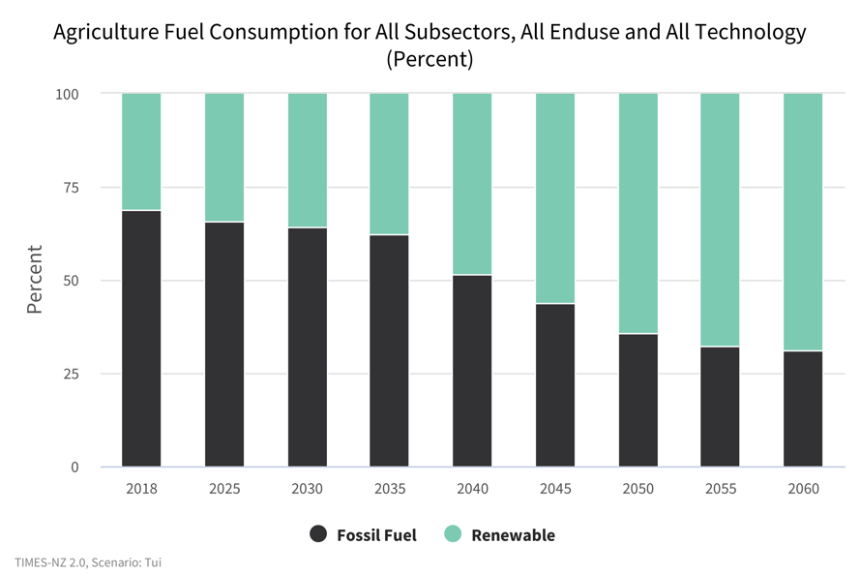
Agriculture
What does the model say about agricultural energy sources?
Kea
Tūī
Notes:
Agriculture - What does the model say about the energy sources?
Neither Kea or Tūī show full consumption of renewable energy. This is largely due to the role of diesel, which ensures the presence of at least some reliance on fossil fuels.
Demand for renewable energy increases as a percentage of overall demand in both Kea and Tūī, although this process takes longer under the more conservative Tūī. A lack of available renewable heavy machinery technology will be responsible for longer reliance on fossil fuels.

Slide 34
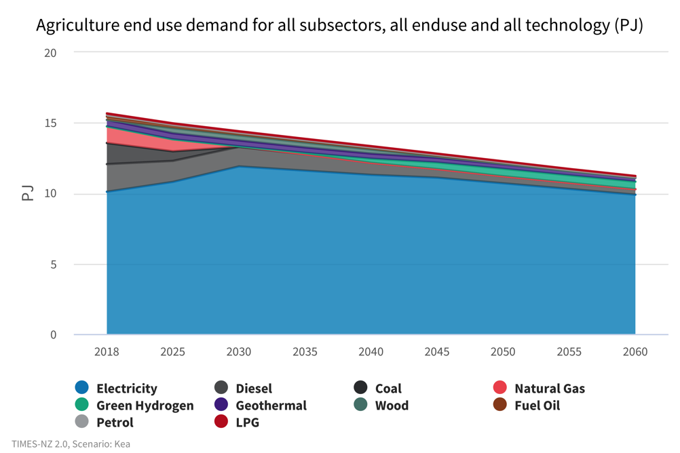
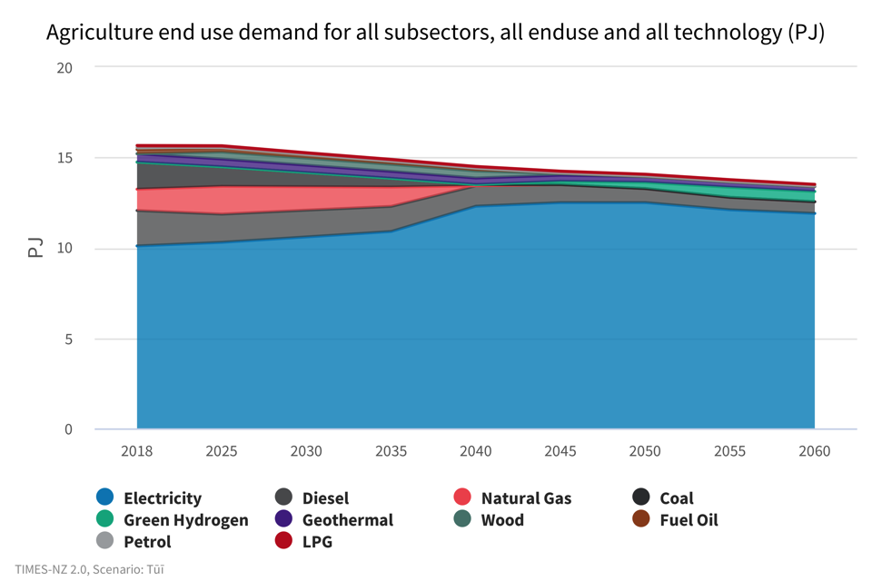
Agriculture
What fuels might we be consuming?
Kea
Tūī
Notes:
Agriculture - What fuels might we be consuming?
Diesel and electricity continue to be the main sources of fuel for the agricultural sector. There is not a substantial difference in the percentage consumption of these fuels between Kea and Tūī at either the 2030 or 2050 intervals.
Under Kea in 2030, diesel makes up 53%, with electricity at 38%. These numbers shift to 27% and 51% respectively by 2050.
Under Tūī in 2030, diesel makes up 49%, with electricity at 32%. These numbers shift to 35% and 53% respectively by 2050.
Hydrogen technology in tractors, skidders, trucks and other heavy vehicles are largely responsible for this shift, in addition to a broad transition away from natural gas, LPG and coal. The development of hydrogen tech in this sector will be crucial to seeing increased reductions in emissions. It is difficult to power such vehicles using electricity due to prohibitive battery weight.

Slide 35
TIMES-NZ Scenarios
Industrial

Slide 36
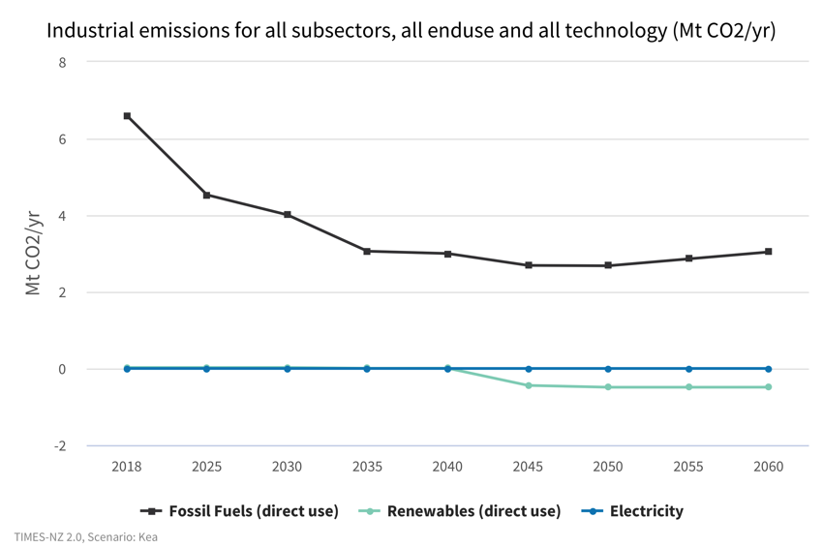
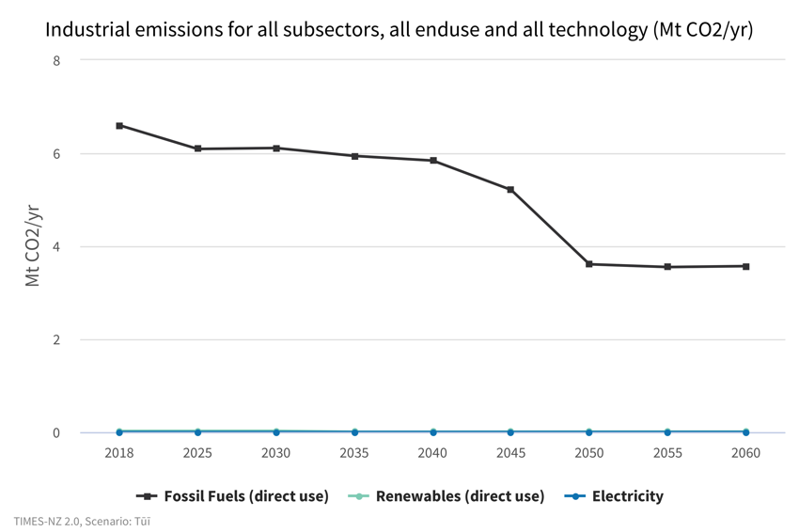
Industrial
How much industrial decarbonisation does the model show?
Kea
Tūī
Notes:
Industry - How much industrial decarbonisation does the model show?
Industrial emissions roughly halve in the scenario timeframe, dropping from 6.6 Mt CO2-e to between 2.68 and 3.61 Mt CO2-e in 2050.
In Kea, emissions mostly reduce between now and 2040 then level off. Some negative emissions are created due to biodiesel production.
In Tūī, emissions remain relatively unchanged until 2040, then decline.
Faster decarbonisation is driven by the higher carbon prices assumed in Kea.
Residual emissions are from hard-to-abate sectors like steel making.

Slide 37
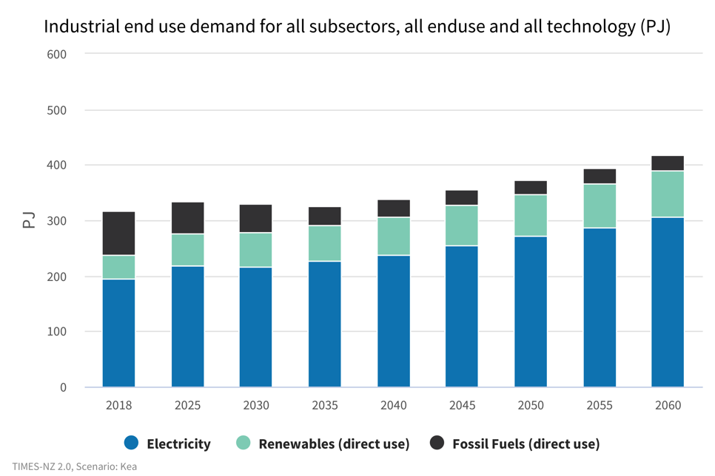
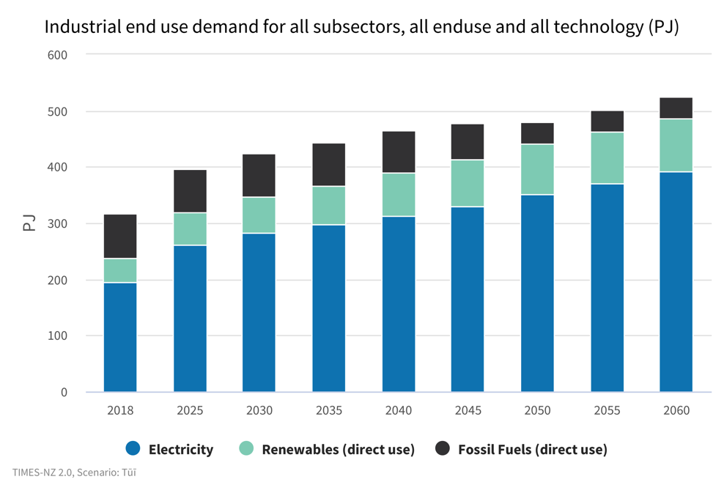
Industrial
What might industrial demand look like?
Kea
Tūī
Notes:
Industrial - What might industrial demand look like?
The total industrial end-use demand looks quite different in our two scenarios.
Total demand is held below 400PJ until 2050 in Kea. Fossil fuel use drops to 31.5 PJ in 2040, half of its current demand.
Demand for renewable energy sources grows gradually. There is greater growth in Tūī, with industrial energy demand jumping to 396 PJ by the first milestone year, 2025, and continuing to increase until 2045.
Future industrial end-use demand is generally driven by national or sector-specific GDP projections, taking into consideration any capacity constraints. Kea assumes a low-growth period over the next 10 years with a transition period from 2030 to 2040 followed by higher growth. In contrast, Tūī assumes higher growth between now and 2030, followed by a 10-year transition period and then lower growth.
During the low-growth periods wood product manufacturing is assumed to outperform other sectors as timber and associated products become an important domestic and global economy. On the other hand, metal product manufacturing is assumed to under-perform as industry moves away from emissions-heavy energy consumption.
The model results show the industrial sector requiring a mix of fuels including some fossil feedstocks. A number of sectors move away from fossil fuels altogether. However, hard to abate sectors like steelmaking do not yet have economic alternatives available in the model, and so remain on fossil fuels.

Slide 38
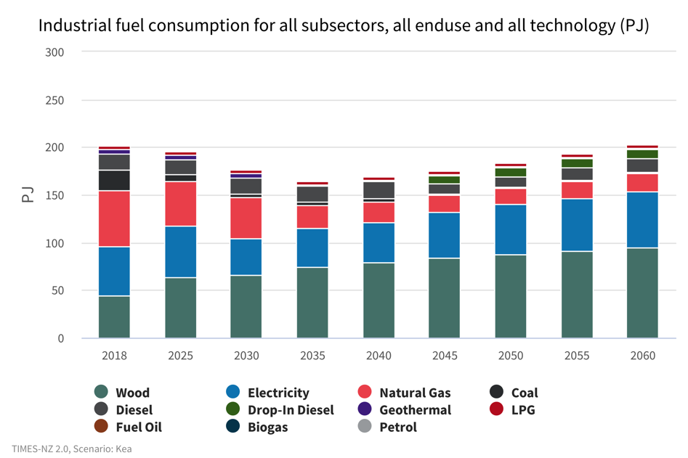
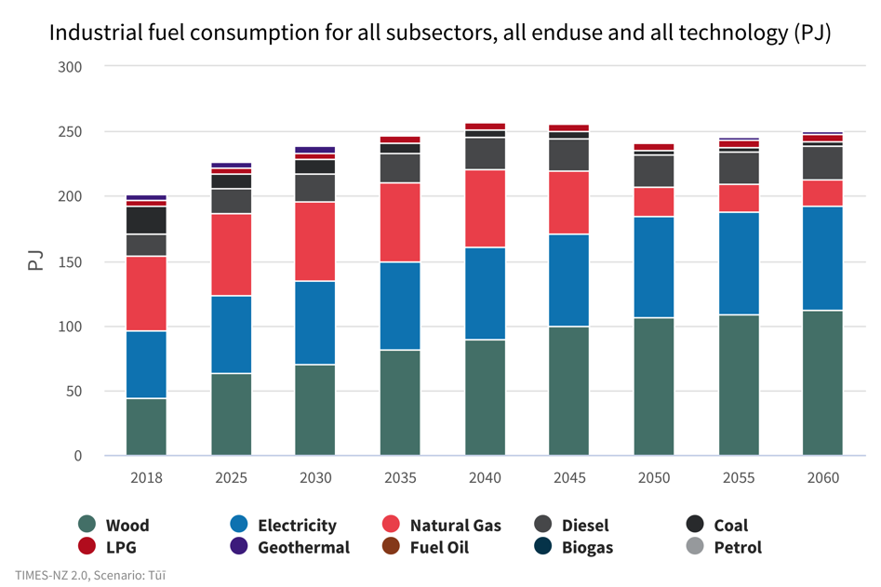
Industrial
What fuels might industry use?
Kea
Tūī
Notes:
Industrial- What fuels might industry use?
Overall fuel consumption decreases in Kea until 2035, dropping from 202PJ to 165PJ as industry switches to more fuel-efficient options. Drop-in diesel is used from 2045 onwards as it becomes an economically viable option. In Tūī, higher natural gas and coal consumption continue as important feedstocks for industry.
Natural gas consumption falls in both scenarios, from 57 PJ to 16 PJ (Kea) and 22 PJ (Tūī) by 2050. This is largely driven by the loss of methanol production in New Zealand in 2032 in Kea and 2047 in Tūī, due to increasing carbon prices and dwindling access to gas supply. Under Kea, the use of natural gas for methanol and dairy product manufacturing would end by 2035, while in Tūī gas use continues until 2045 for methanol production, and 2050 for dairy product manufacture. Gas would also be removed from refining under Kea but would continue in Tūī.
Coal consumption is reduced from providing 20 PJ currently down to 1.6-2.5 PJ in 2050. Coal is removed from dairy product manufacturing, other food processing and wood product manufacture by 2030 in Kea, and 2040 in Tūī.

Slide 39
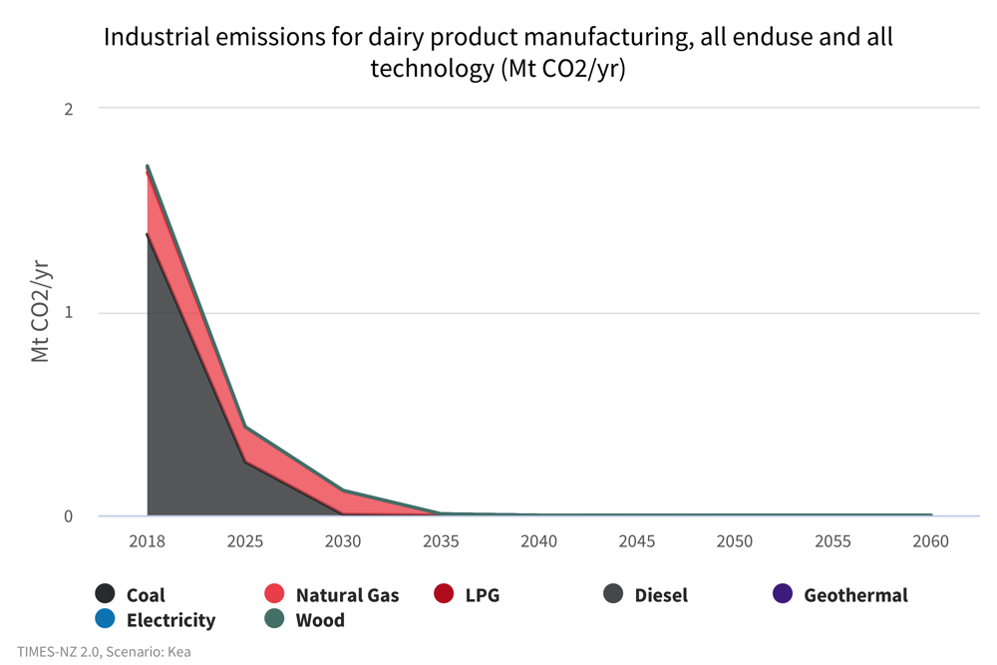
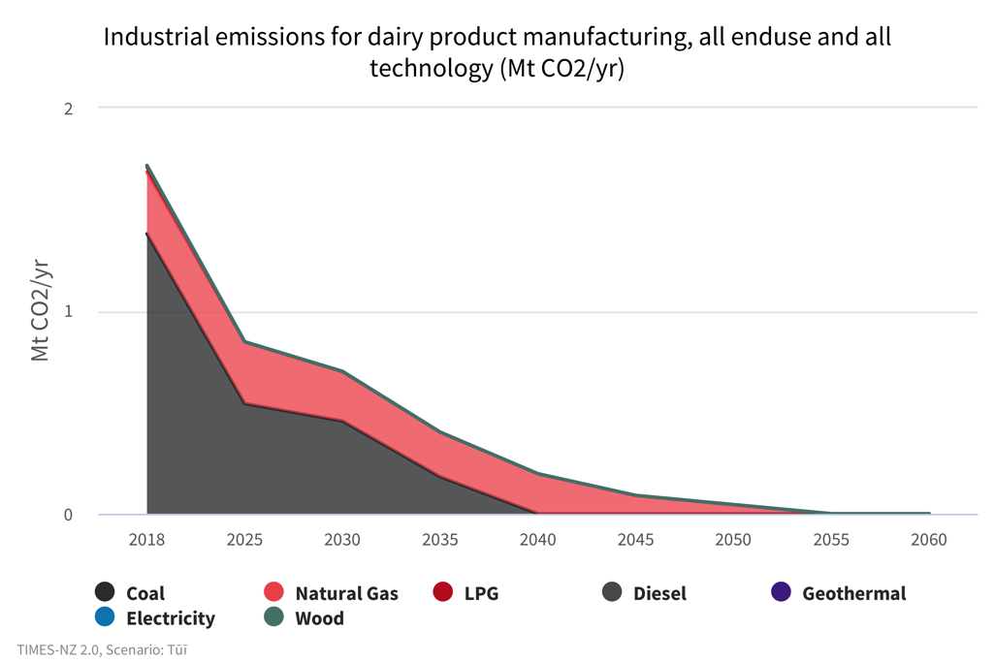
Industrial
What sectors might fully decarbonise?
Kea
Tūī
Notes:
Industrial - What sectors might fully decarbonise?
Emissions reductions are largely due to the removal of coal and reduction of gas use by the sector.
A gradual growth in construction and mining emissions is offset by significant emissions reductions associated with the manufacture of dairy products driven by a significant reduction in the use of coal.
As natural gas and coal are removed from dairy product manufacturing, emissions from this subsector drop from 1.7 Mt CO2-e today, to zero in 2035 in Kea, and zero in 2055 under in Tūī. However, emissions for some subsectors including construction, mining and wood product manufacturing are expected to rise. This is mainly due to a lack of low emissions technologies modelled in these sectors so far.

Slide 40
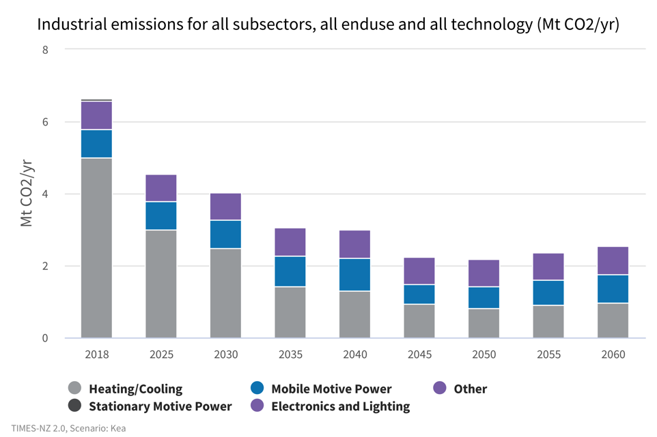
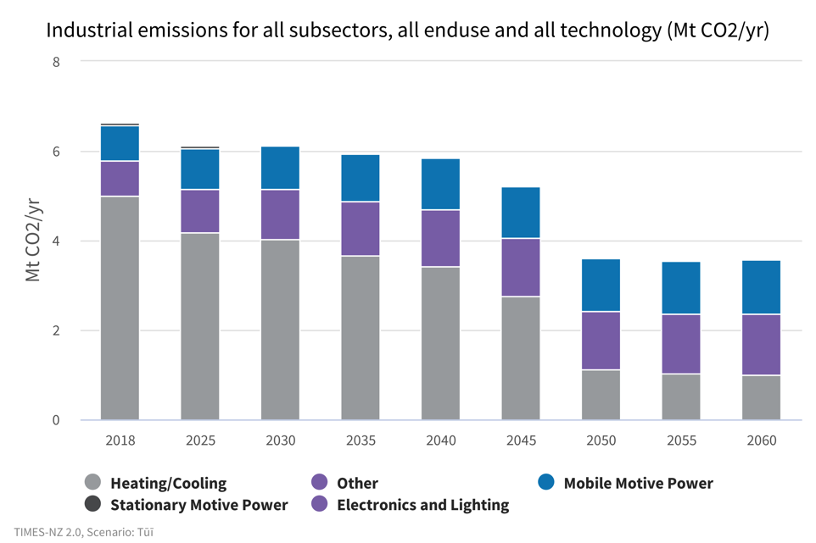
Industrial
Which technologies decarbonise more readily?
Kea
Tūī
Notes:
Industrial- Which technologies decarbonise more readily?
The largest reductions in industrial sector are from heating and cooling systems. In Kea, heating and cooling drops from producing 5 Mt CO2-e to 0.8 Mt CO2-e in 2050. Similarly, heating and cooling technology emissions drop to 1 Mt CO2-e in Tūī.
This is largely driven by reduced emissions from boilers as industry selects lower emission fuel sources.

Slide 41
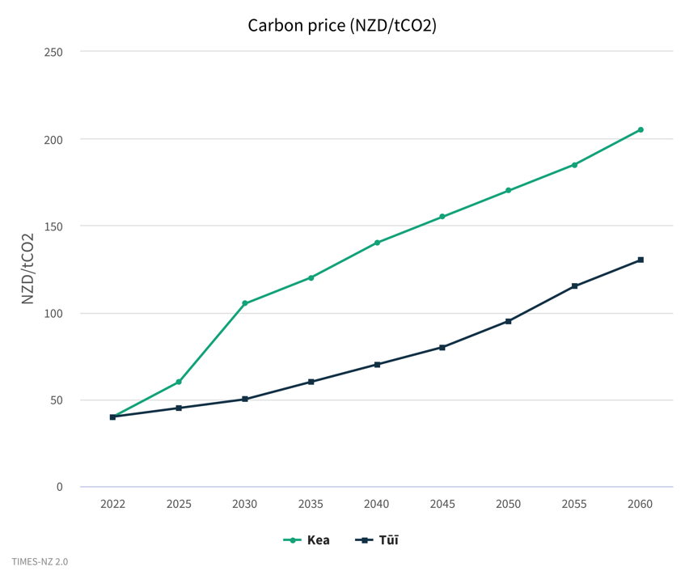
Industrial
What are the trade-offs and choices?
Notes:
Industrial - What are the trade-offs and choices?
In Kea, GDP growth slows, building again from 2050 onwards. The carbon price increases above the $100 mark by 2030 but industrial emissions reductions are achieved much earlier halving from 6 Mt CO2-e to 3 Mt CO2-e by 2035.
In Tūī, the carbon price remains lower for longer, not surpassing the $100 mark until after 2050. However, industrial emissions don’t drop as far or as fast; between 2040 and 2050 emissions reduce from 5.8 Mt CO2-e to 3.6 Mt CO2-e.
GDP growth remains consistent until it is overtaken by Kea in 2050.
In the industrial sector a faster reduction of emissions is related to earlier closure of local industries, including methanol, aluminium, and refining.

Slide 42
TIMES-NZ Scenarios
Commercial

Slide 43
Commercial
What will end-use demand look like?
Kea
Tūī
Notes:
Commercial - What will end-use demand look like?
In Kea, demand increases significantly from 2030 onwards, from 7 PJ to 14 PJ. Most of this demand increase is met by electricity, however natural gas and LPG also increase to meet this. This differs from Tūī where demand levels off at 9 PJ by 2035. This is due to Kea having significant GDP growth in the second half of the scenario, most of which comes from the commercial sector.
Direct use geothermal plays a significant role in this sector, however the geothermal output decreases from 2018 to 2050 in both scenarios, partly due to rising carbon prices affecting the residual GHG emissions from geothermal.
Gas use rises in end uses. There are economic alternatives to gas available for the model, however, in the model it was cheaper to retain some gas in commercial rather than building more generation.

Slide 44
Commercial
Where might we see emissions decrease?
Kea
Tūī
Notes:
Commercial – Where might we see emissions decrease?
In the commercial sector, the majority of emissions comes from mobile power and heating/cooling.
In both scenarios, emissions fall significantly through to 2050, from 1.0 Mt CO2-e in 2018 to 0.37 Mt CO2-e in Kea and 0.33 Mt CO2-e in Tūī.
In Tūī, emissions level off beyond 2050, whereas in Kea they begin to increase again as demand for heating/cooling rises. In Kea, the economy has shifted away from an agricultural, goods-based economy and to a high value products and services economy. This has resulted in increasing energy demand in the commercial sector compared to Tūī which has an economy that continues to rely on agriculture and industrial production.
Mobile motive power emissions decrease quickly in Kea, from 0.25 Mt CO2-e to 0.02 Mt CO2-e by 2030 and zero by 2050. Tūī has a slower decrease in emissions to 0.1 Mt CO2-e and zero in 2050. In both scenarios there is a transition to zero emissions vehicles.

Slide 45
Commercial
What could the emissions footprint in the commercial sector look like?
Kea
Tūī
Notes:
Commercial - What could the emissions footprint in the commercial sector look like?
Overall emissions in the commercial sector decrease rapidly in both scenarios from a peak of 1 Mt CO2-e in 2018 to less than 0.5 Mt CO2-e by 2050.
This is primarily driven by reduction in diesel, petrol, LPG and coal consumption as mobility vehicles electrify and coal heating systems are phased out. In Kea, we see a faster decline in emissions which reach their lowest by 2040 of 0.36 Mt CO2-e before beginning to trend upwards.
In Kea, natural gas use initially decreases slightly from 0.45Mt CO2 to 0.39 Mt CO2-e by 2030 and 0.33 Mt CO2-e by 2050 but begins trending upwards again as demand increases.
This contrasts to Tūī, which sees emissions continue to stay around 0.45 Mt CO2-e through to 2030 before more rapidly decreasing to 0.29 Mt CO2-e by 2050 and levelling off. This is due to rising demand in the later time-steps for Kea, particularly for end-uses without a modelled effective low emissions alterantive.

Slide 46
Commercial
How might we manage increasing demand?
Kea
Tūī
Notes:
Commercial - How might we manage increasing demand?
The majority of fuel consumption in office blocks for both scenarios already comes from electricity. A significant proportion of fuel consumption is from diesel for transport, but this reduces to zero by 2030 in Kea and 2040 in Tūī. This is driven by increasing carbon prices and lowering costs of electric vehicles making them more attractive options for transport.
Increasing demand is met by electricity, rather than fossil fuels. Some fossil fuels however, (LPG and natural gas), remain in the system in both scenarios for water heating.

Slide 47
TIMES-NZ Scenarios
Residential

Slide 48
Residential
What energy sources might we use at home?
Kea
Tūī
Notes:
Residential - What energy sources might we use at home?
In both scenarios, the overall fuel consumption is relatively steady, despite increasing population, and plateaus at around 70 PJ of energy consumption by 2050. This is already mostly met by electricity and is 100% electric from 2040.

Slide 49
Residential
What is the potential for homes to reduce carbon emissions?
Kea
Tūī
Notes:
Residential - What is the potential for homes to reduce carbon emissions?
There is little difference in the distribution of fossil fuel and renewable demand between Kea and Tūī for residential energy and both scenarios are zero emissions in 2040. Renewable electricity already makes up 90% of residential energy consumption. Most emissions in the residential sector come from cooking and heating (for both water and space). This provides tangible areas where decarbonisation can be targeted. Wood is considered as a renewable fuel and is used for heating in burners but will be phased out by 2040 in both scenarios.
In Kea, decarbonisation initially happens faster, dropping from 0.53 Mt CO2-e to 0.37 Mt CO2-e by 2025 before levelling off until 2035 and then again dropping sharply to zero by 2040.
Tūī has a more gradual decrease in emissions, falling to 0.43 Mt CO2-e by 2025 and 0.38 Mt CO2-e in 2030. Emissions in Tūī then quickly fall to zero by 2040. Both coal and LPG emissions reduce at a similar rate in both scenarios, with the difference in decarbonisation profiles due to slower decarbonisation of natural gas.
The decarbonisation timeline for these appliances is based on the assumption that there will be no new fossil fuel powered heating units installed after 2018. As older units reach their projected 20-year lifecycle they will be replaced by electric units and so all are assumed to be phased out by 2040.

Slide 50
Residential
What energy source might we use for heating?
Kea
Tūī
Notes:
Residential - What energy source might we use for heating?
Both scenarios have the same amount of energy provided for by fossil fuels, including a large proportion of energy for heating provided by burning wood which decreases from 6.35 PJ to 4.62 PJ in 2025 for both scenarios.
In Kea, however, there is a larger increase in electricity consumption to 18.9 PJ in 2035 before falling to 15.8 PJ in 2040 as fossil fuels are phased out. This is not reflected in Tūī, where electrical demand increases steadily to 2040 and levels off at 17PJ at the same time as fossil fuels are phased out.
The higher electricity consumption in Kea before 2040 can be attributed to the assumption that the GDP growth is slower than in Tūī. This results in people choosing less energy efficient appliances and they are not incentivised to switch out aging systems before the end of their life due to the higher capital cost and lower wealth to afford new appliances.

Slide 51
Residential
What technology might we use in our homes?
Kea
Tūī
Notes:
Residential- What technology might we use in our homes?
Residential energy demand increases as the number of houses nationwide increases, offset to some extent by efficiency gains.
In Tūī, population, and therefore demand increases faster, reaching 88 PJ in 2030 and 93 PJ in 2050, whereas the Kea scenario has slower growth in demand to 81 PJ in 2030 and 91 PJ by 2050.
In both scenarios, coal and gas heaters are phased out and replaced by heatpumps (multi-split) powered by electricity. Multi-split heatpumps increase from zero to 33.9PJ and 37% of the energy demand by 2050.
In both scenarios, burners used for hot water are phased out by 2040 and are replaced by hot water cylinders which increase share of energy demand from 22% to 29% by 2050.
In this model, gas heaters are primarily fueled by natural gas and LPG while burners are fueled by wood or coal. It can be seen that the difference in decarbonisation profiles between Kea and Tūī is due to continued higher use of gas heaters in Tūī while the use of wood burners remains similar between the two scenarios.

Slide 52
This project has been brought to you by
Find out more at
times.bec.org.nz

