Slide 1
New Zealand Energy Scenarios

Slide 2
TIMES-NZ Scenarios
Introduction

Slide 3
How do you tell the story of the future?
What if most Kiwis chose to see climate change as the most important problem to solve?
What would happen if they invested now in new technologies and led the world in decarbonising the economy?
How would New Zealand’s energy sector evolve?
What are the choices and trade-offs?

Slide 4
TIMES-NZ Scenarios
Kea and Tūī

Slide 5
Kea (cohesive) Kea represents a scenario where climate change is prioritised as the most pressing issue and New Zealand deliberately pursues cohesive ways to achieve a low-emissions economy
Tūī (individualistic) Tūī represents a scenario where climate change is an important issue to be addressed as one of many priorities, with most decisions being left up to individuals and market mechanisms

Slide 6
TIMES-NZ Scenarios
Transport

Slide 7
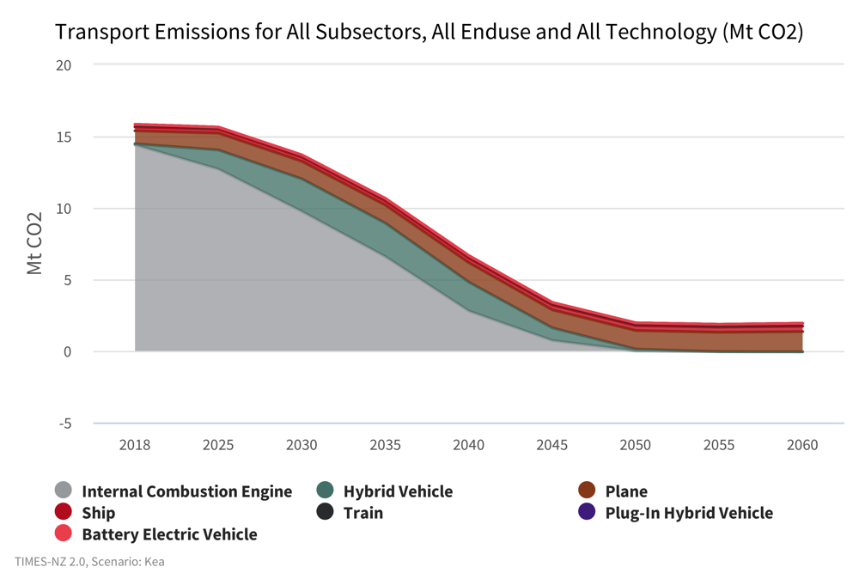
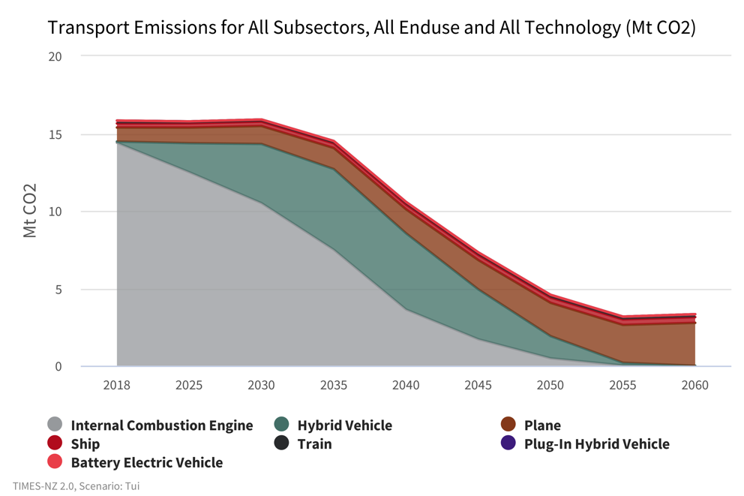
Transport
What technology might help us to lower our carbon footprint?
Kea
Tūī
Notes:
Transport - What technology might help us to lower our carbon footprint?
Transport contributes roughly 20% of New Zealand’s gross emissions, about the same as energy use. The vast bulk of that comes from road transport.
Transport emissions have increased more than any other emissions source, rising 90% between 1990 and 2018 compared with 24% for gross emissions across the whole economy.
In Tūī, emissions plateau before slowly declining closer to 2030. In Kea, we see emission reductions happening after 2025.
In Kea, emissions begin to fall immediately as the emissions from internal combustion engines fall, as electric and hybrid vehicle uptake accelerates, and modeshift slowly rises in the overall vehicle-kilometres travelled. Hybrid vehicles act as a transition technology, peaking in 2030 before reducing to zero by 2050. Both internal combustion and hybrid vehicle emissions drop to zero by 2050.
In Tūī, overall emissions remain steady to 2030. This plateau in Tūī is attributed to reductions in emissions from electric and hybrid vehicles being offset by the increasing vehicle fleet. There are more than double the emissions from hybrid vehicles in Tūī compared to Kea as they are more widely adopted in Tūī due to carbon price and technology cost and perfroamnce assumption differences between the two scenarios.

Slide 8
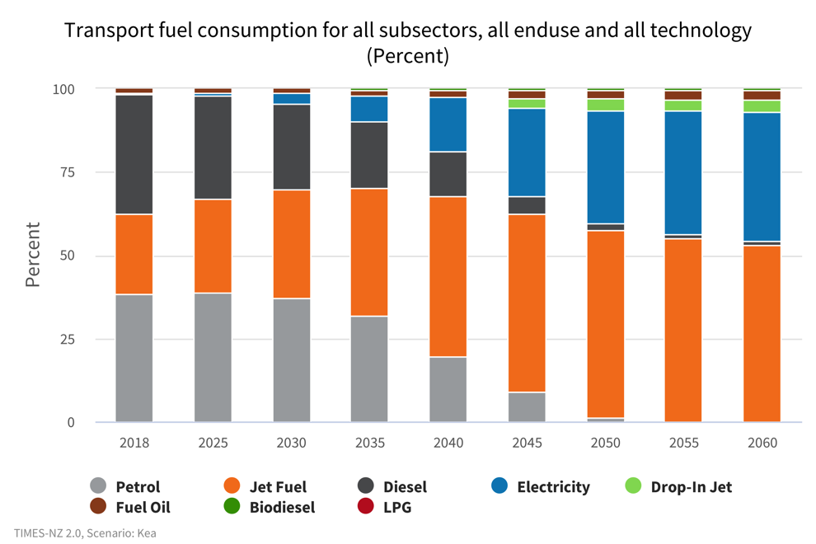
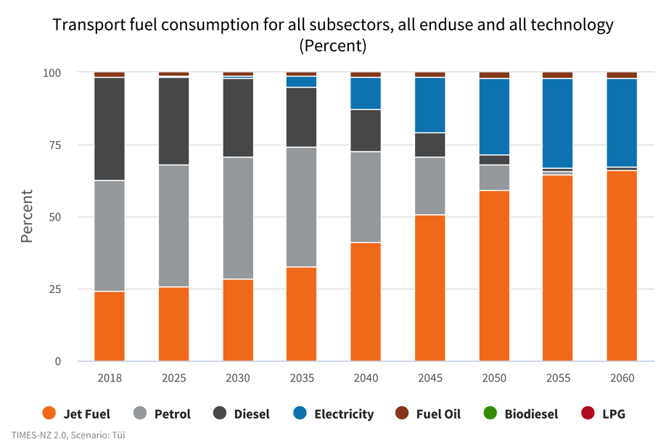
Transport
How might fuel consumption impact our emission footprint?
Kea
Tūī
Notes:
Transport - How might fuel consumption impact our emission footprint?
In Kea, emissions begin to fall immediately, from 15.8 Mt CO2-e in 2018 to 13.69 Mt CO2-e in 2030, then to 3.6MtCO2-e by 2050. This is driven by reduction in petrol and diesel consumption as more vehicles transition to electric faster.
This is in contrast with Tūī where emissions remain steady to 2030 before falling to 4.57 Mt CO2-e by 2050.
In Kea emissions level off by 2050 at around 2.18 Mt CO2-e, suggesting that the minimum level of carbon emissions has been reached with current technology. This is because technologies for decarbonising the airline industry are still under development which by 2050 makes up for more than 50% of fuel consumption.
Diesel emissions decrease steadily in both scenarios from 7.28 Mt CO2-e to 0.25 Mt CO2-e in Kea and 0.65 Mt CO2-e in Tūī. This decrease in diesel emissions is offset in Tūī, however, by rising petrol emissions through to 2030.
In Tūī, emissions from petrol increase from 7.43 Mt CO2-e to 8.67 Mt CO2-e in 2030 before falling.
Jet fuel emissions increase more in Tūī by 2050 from 0.907 Mt CO2-e to 2.15 Mt CO2-e as the demand for air travel increases. This contrasts with Kea where jet fuel emissions increase more modestly to 1.46 Mt CO2-e.

Slide 9
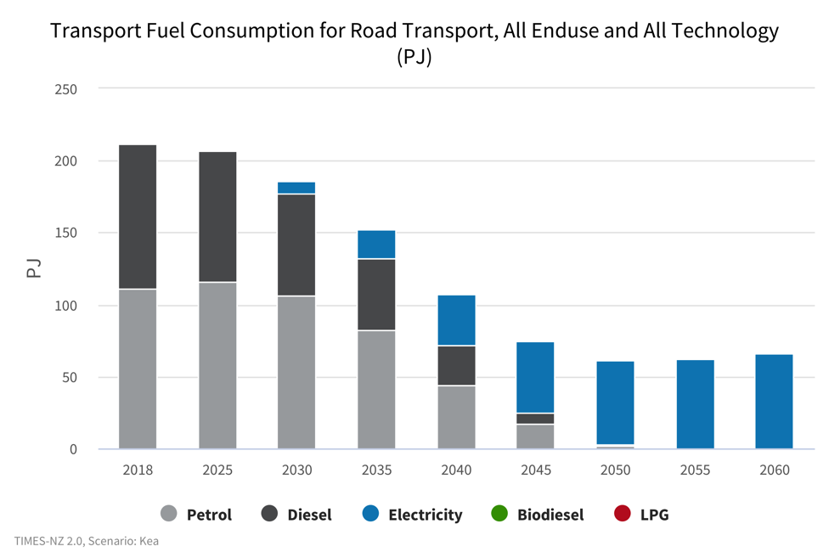
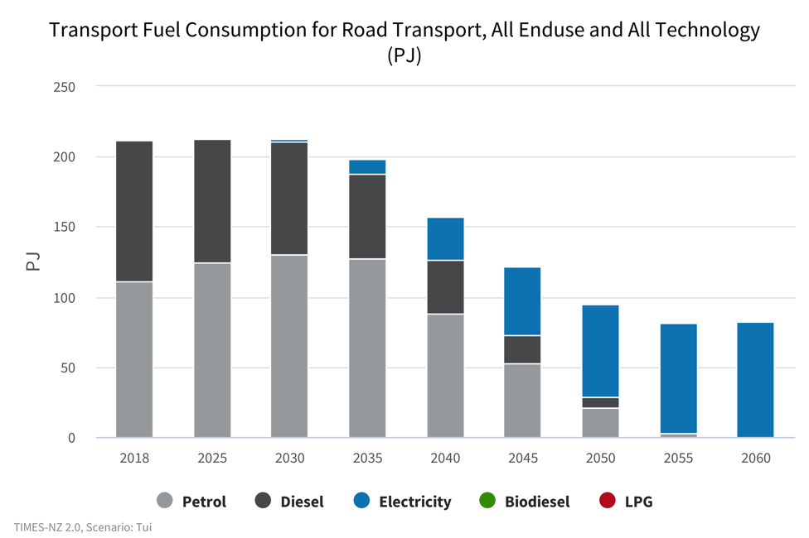
Transport
How might road transport look?
Kea
Tūī
Notes:
Transport- How might road transport look?
The road transport system shows a major shift in energy from the current 100% fossil fuel to almost entirely electric by 2050 (Kea) and 2055 (Tūī).
In Kea, by 2050 fuel consumption is 95% electric while in Tūī, 60% of energy consumption will be electric. Note that fuel consumption shares do not reflect travel as electric vehicles are much more energy efficient.
In Tūī, petrol consumption increases to 2030 as the number of overall vehicles increases, with reductions in energy consumption from diesel being offset by increased consumption of petrol. The phasing out of fossil fuels is slower than in Kea, with petrol remaining a larger share of energy consumption for longer before being more slowly replaced by electricity.
Diesel takes longer to be phased out in Tūī, with 7 PJ of diesel still being consumed by 2050 compared to no diesel by 2050 in Kea. This is due to the higher cost of battery electric vehicles for longer, and larger fleet in Tūī which results in a slower phaseout.
Overall energy consumption for road transport drops from 212 PJ to 61 PJ by 2050 in Kea and 94.5 PJ in Tūī. This is due to the more efficient nature of electric vehicles compared to internal combustion engines and so less energy is required to complete transport tasks.

Slide 10
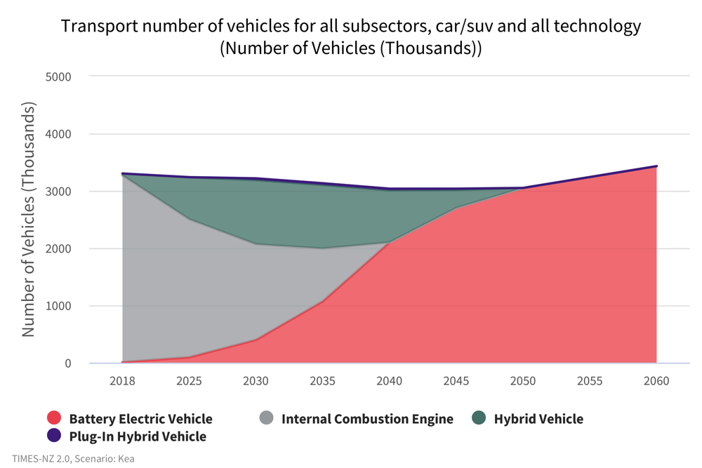
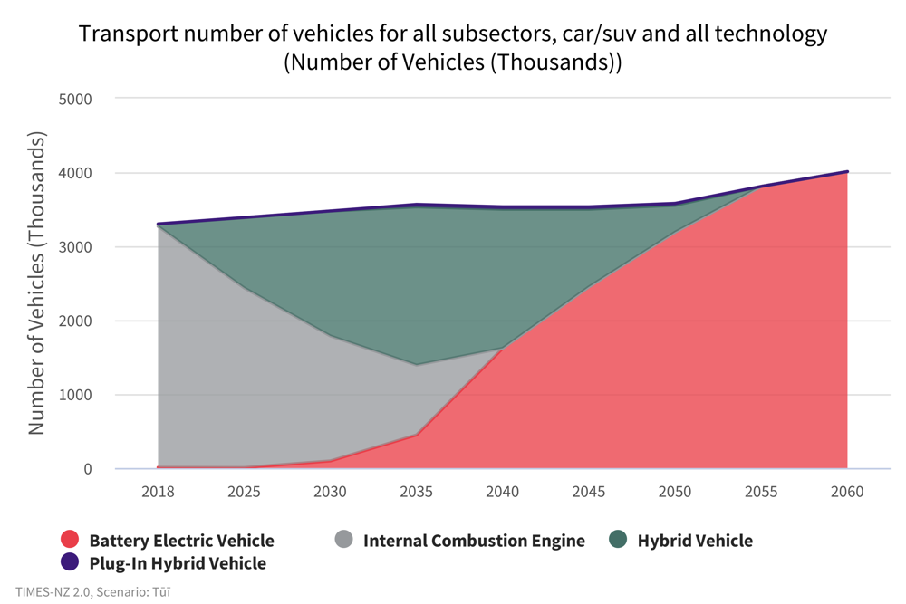
Transport
What cars might we drive?
Kea
Tūī
Notes:
Transport - What cars might we drive?
The number of cars and SUVs in Kea decreases slightly through to 2050 from 3.3 million to 3.0 million, compared with Tūī where vehicle numbers increase slightly from 3.3 million to 3.6 million by 2050.
In Tūī, cities continue to grow and sprawl, resulting in greater need for cars and therefore higher overall numbers. In Kea, cities are designed to encourage modeshift to public transport and active transport which results in lower overall demand for vehicles compared to Tūī.
Kea also sees a faster uptake of electric cars as their price falls more quickly, and other technology parameters improve faster, making them a more attractive option to replace internal combustion engine vehicles. By 2050 there are more electric vehicles in Tūī than in Kea. However, there are still more than half a million fossil fuel powered vehicles (albeit more efficient hybrids).
In Tūī, hybrid vehicles are preferred in the short term due to relative costs which result in greater numbers purchased to replace internal combustion engines, and they make up over half of cars by 2035. However, these are quickly replaced by battery electric vehicles from 2040-2050 as BEV price falls and they become cheaper to own than hybrid vehicles.
HEVs are preferred in Tūī as BEV supply is constrained to model lower access to BEVs.

Slide 11
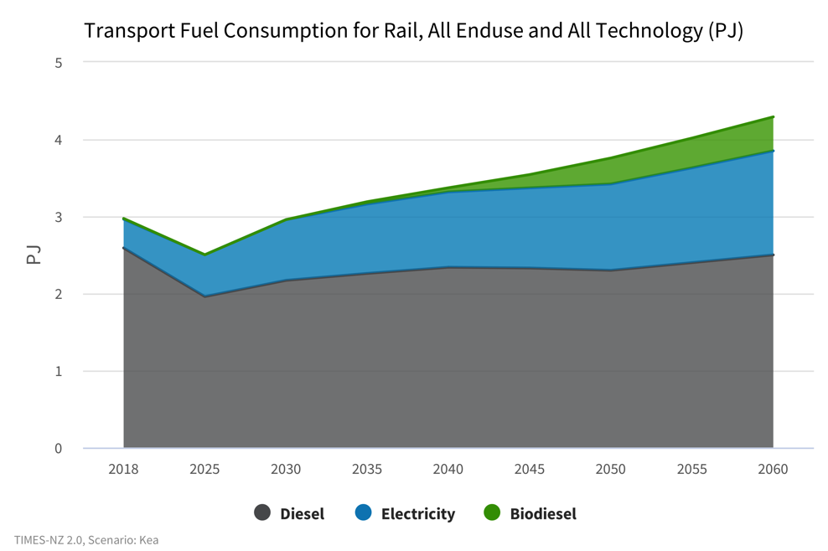
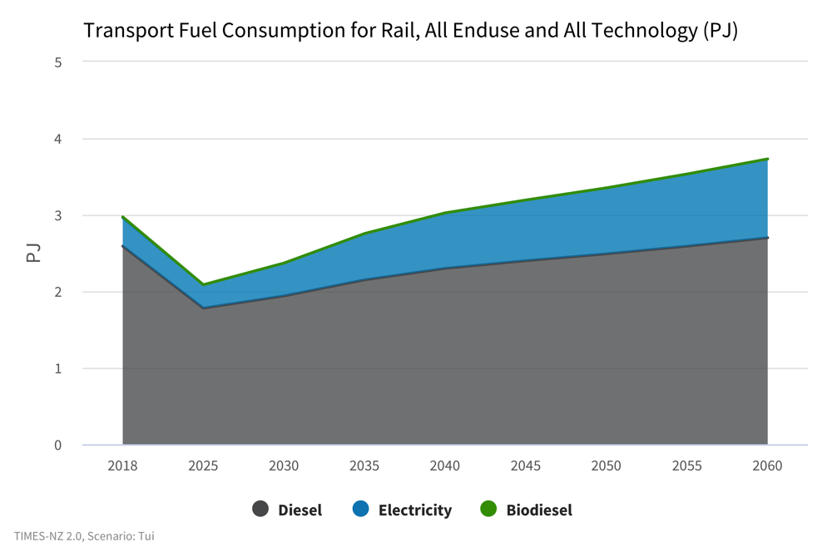
Transport
What might drive our energy consumption in rail?
Kea
Tūī
Notes:
Transport - What might drive our energy consumption in rail?
Fuel consumption decreases in both scenarios through to 2025 before then increasing.
In Kea, demand grows larger than in Tūī due to rail being prioritised as a lower emissions alternative to road transport. In Kea, energy consumption grows to 3.76 PJ in 2050 whereas in Tūī it climbs to 3.35 PJ.
Diesel consumption drops from 2.59 PJ in 2018 to 2.17 PJ in 2030 and only increases slightly to 2.3 PJ by 2050. Most of the increase in energy consumption is met by electricity and biodiesel. Biodiesel plays a small nut growing role in Kea, accounting for 9% of energy consumption by 2050.
Tūī on the other hand does not have biodiesel as a part of the energy mix, relying on diesel and electricity. Diesel consumption is slightly higher in Tūī by 2050 at 2.49 PJ compared to 2.3PJ in Kea, and electricity consumption by 2050 is lower at 0.86 PJ compared to 1.12 PJ in Kea. This means that in 2050, fossil fuels will still make up a much larger percentage of the energy use mix at 74% in Tūī compared to only 61% fossil fuels in Kea.
Overall emissions increase in both Kea and Tūī, as demand and consumption of diesel increases. Emissions decrease from 2018 levels of 0.18 Mt CO2-e to 0.15 Mt CO2-e in Kea and 0.13 Mt CO2-e in Tūī by 2030. By 2050, emissions in Kea grow back to 0.18 Mt CO2-e and Mt CO2-e in Tūī. Higher emissions in Kea are attributed to higher demand for rail travel through mode shift away from road transport.
The rail sector shows opportunities to offset emissions through the introduction of biofuels. This can be seen in Kea where there are significant offsets through the introduction of biofuels which absorb carbon as they are grown. By 2050, biofuels in Kea will offset emissions by 14% and resulting in net emissions in Kea that are lower than Tūī despite higher fuel consumption.

Slide 12
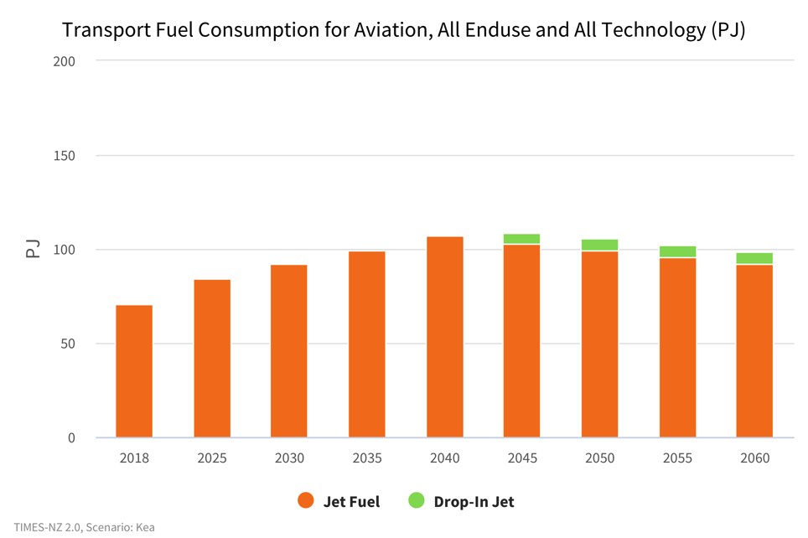
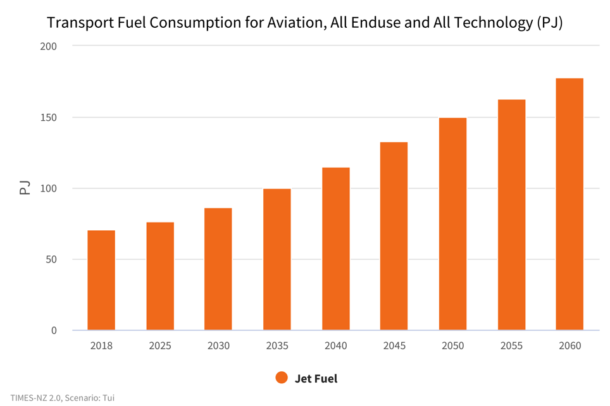
Transport
What is the role of demand reduction for areas that are difficult to decarbonise?
Kea
Tūī
Notes:
Transport- What is the role of demand reduction for areas that are difficult to decarbonise?
The aviation industry is an area where decarbonisation is challanging. There are currently no economically viable alternatives to jet fuel for aviation, with biofuels and forms of hydrogen being currently researched to be introduced.
In Kea and Tūī, demand management results in differences in fuel consumption and therefore emissions. In Kea, consumption continues to grow from 2018 levels to peak in 2040 and fall slightly to 99.2 PJ in 2050. This is caused by reduction in demand for air travel as modeshift to lower emissions travel such as by train for short trips is encouraged. This differs to Tūī where demand for jet travel continues to increase at a steady rate, resulting in 50% more fuel consumption at 150 PJ by 2050.

Slide 13
This project has been brought to you by
Find out more at
www.times.bec.org.nz

